Slide 1

HERE Applications and Services

Slide 2
Platform
Portfolio
Automated
Driving
Fleet
Tracking
Advertising
Thinking
Buildings
Connected Driver
Experience
Automotive
Transport
& Logistics
TMT
Public Sector
XXX
XXX
XXX
Marketplace
Apps & Services
Mobility, HAD, Tracking, Positioning, Indoor, Fleet Svcs, AdTech, Nav SW, Nav on Demand, Traffic, CVS
Platform
HLS, OLP, XYZ
Data & Content
SD & HD Map Content
Notes:
Optimize products throughout the lifecycle...
New requirements supporting adjacent industry segments, regions
New requirements supporting individual customer delivery (e.g., solution selling)

Slide 3
HERE Applications
Customer value for a specific set of industries
Automotive
Applications
Transport & Logistics
Applications
Telecoms Media,
Tech & Retail Applications
Navigation on Demand
Fleet
mSDK
Safety Services
Tracking
Positioning
AdTech
Indoor
Location Suite

Slide 4
A year in review
HERE Applications & Services

Slide 5




Progress in the last 12 months…
HERE Applications:
Portfolio completeness
HERE announces freemium plan for developers to build location-aware applications
HERE extends its suite of location services to China
HERE Navigation on Demand announces next-generation in-vehicle navigation experience with Amazon Alexa integration
HERE Advertising Services empowers companies to create advertising campaigns and audience segmentation for their clients
Safety Services receiving market traction with commercial deals
Tracking application launched in Japan

Slide 6
Applications strategy
HERE Applications & Services

Slide 7
HERE Applications, Solutions and Map & Location Data
… enable an infinite amount of use cases across multiple industry segments
Smart
Cities
Urban
Planning
Drone
Navigation
ADAS
Public services workforce Mgt
Public
Safety Infor-mation
Call Center Mgt
Network Planning
& Optimi-zation
Display
Autonomous
Driving
Emergency
Services
Infra-structure
Mgt
Demand Modelling
Ride
Sharing
Automotive
Public Sector
Telco & Utilities
Churn Analysis
Search
Mobility
Data
Visuali-zation
Business Intelligence
Navi-gation
Routing
Transport
& Logistics
Operations
& Planning
Internet
& Media
Post Trip
Analysis
Fleet
Planning
Big Data Analytics
Segmentation& Targeting
Tracking
Location Display
Location Analysis
Mobile Dispatch
Truck
Navigation
Notes:
Mention Convergence! – It‘s not all black & white

Slide 8
HERE Applications
Customer value for a specific set of industries
Automotive
Applications
Transport & Logistics
Applications
Telecoms Media,
Tech & Retail Applications
Navigation on Demand
Fleet
mSDK
Safety Services
Tracking
Positioning
AdTech
Indoor
Location Suite

Slide 9





Navigation
Solutions
What our customers need…
Freshness
from the Cloud
Upgrades
on demand
One-stop-shop for all vehicle lines
Facilitated
transformation
Map, software and UX remain fresh and new functionality can be added over vehicle life to differentiate from mobile navigation solutions.
Drivers can extend their navigation experience
on-demand, enabling OEMs to create new business models and unlock recurring revenue streams.
Deployment on any IVI platform from full-blown embedded hardware to mobiles allows OEMs to
one-stop-shop for all vehicle lines and trim levels.
Lower entry hurdle to offer digital services. Full integration with HERE OLP enables the OEM to deliver next-gen location and mobility services.
Notes:
Navigation
Automotive OEMs are facing multiple challenges in terms of in-car navigation solution development, such as brand differentiation, brand appeal, high development costs, supply chain complexity, the need to transform navigation businesses from a one-time hardware sale to a mixed model creating additional recurring revenue streams from services, etc.
HERE Technologies offers a solution that combines the best characteristics of embedded and mobile navigation, offered as a SaaS. Hence it is always fresh, offers full vehicle integration, consumer-grade appeal, and on-demand sale of functionality, and can be deployed on any platform.
The solution will give OEMs greater abilities to keep the IVI experience attractive over the lifetime of the vehicle, which of course also means being able to monetize that experience. In addition, customers receive an OEM-branded user interface, ensuring the OEM brand remains front and center in the dashboard and across adjacent out-of-vehicle experiences.

Slide 10
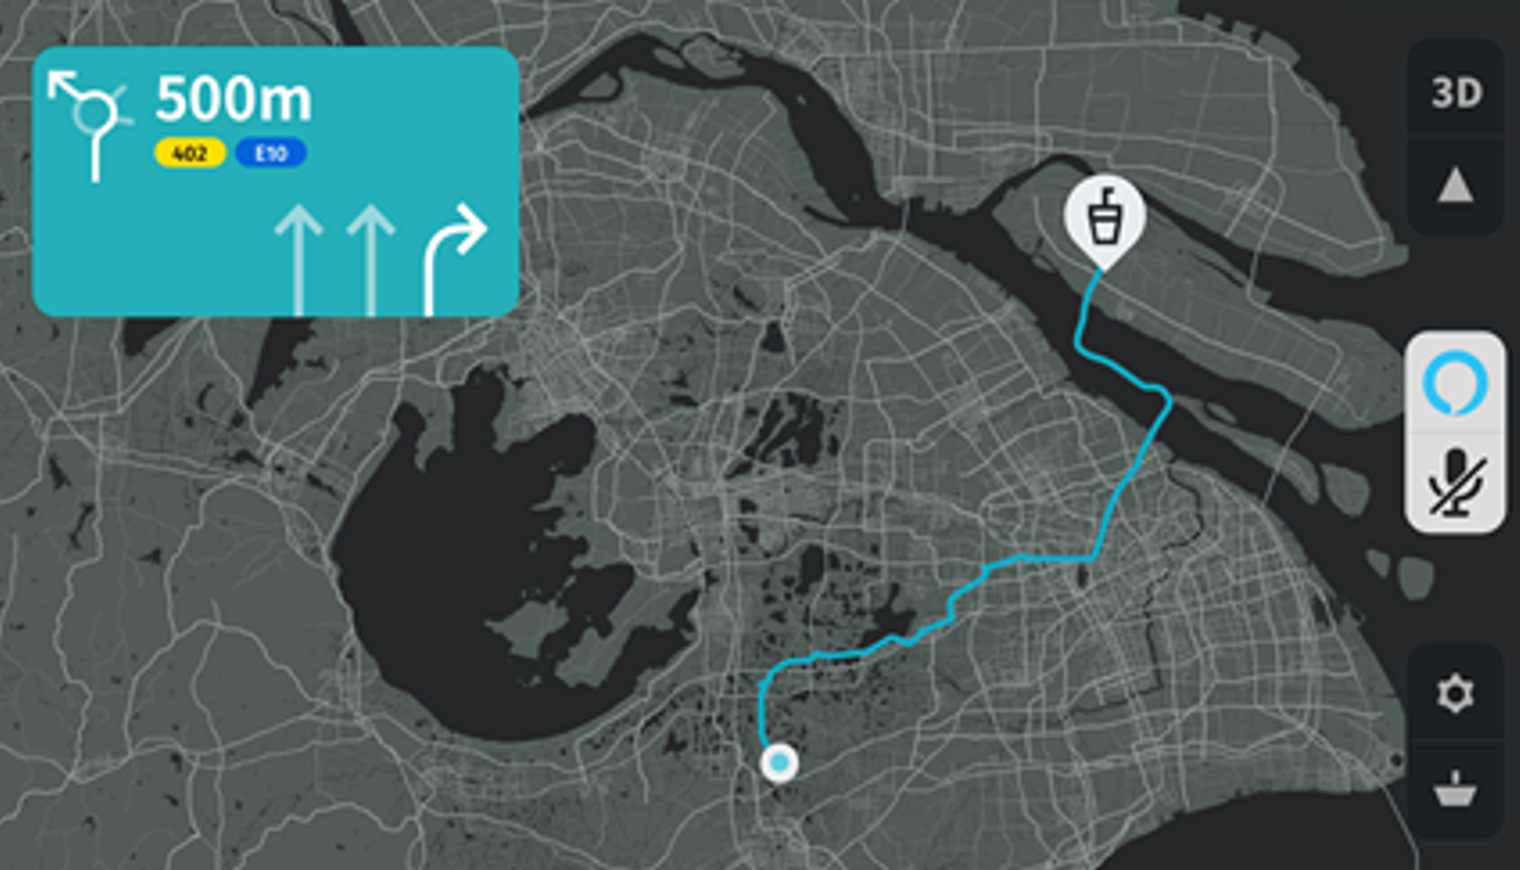
In-car navigation reinvented
HERE announces HERE Navigation on Demand
  Next-generation in-vehicle navigation experience, offered as SaaS
HERE Navigation
on Demand
  Enabling automakers to provide fresh and differentiated navigation experience to drivers and passengers
  Simplifying its supply chain
  and reducing costs

Slide 11
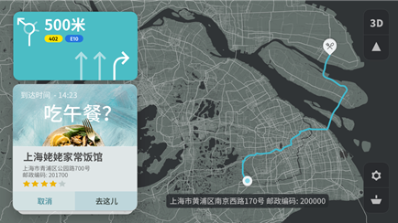
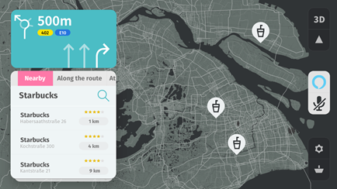
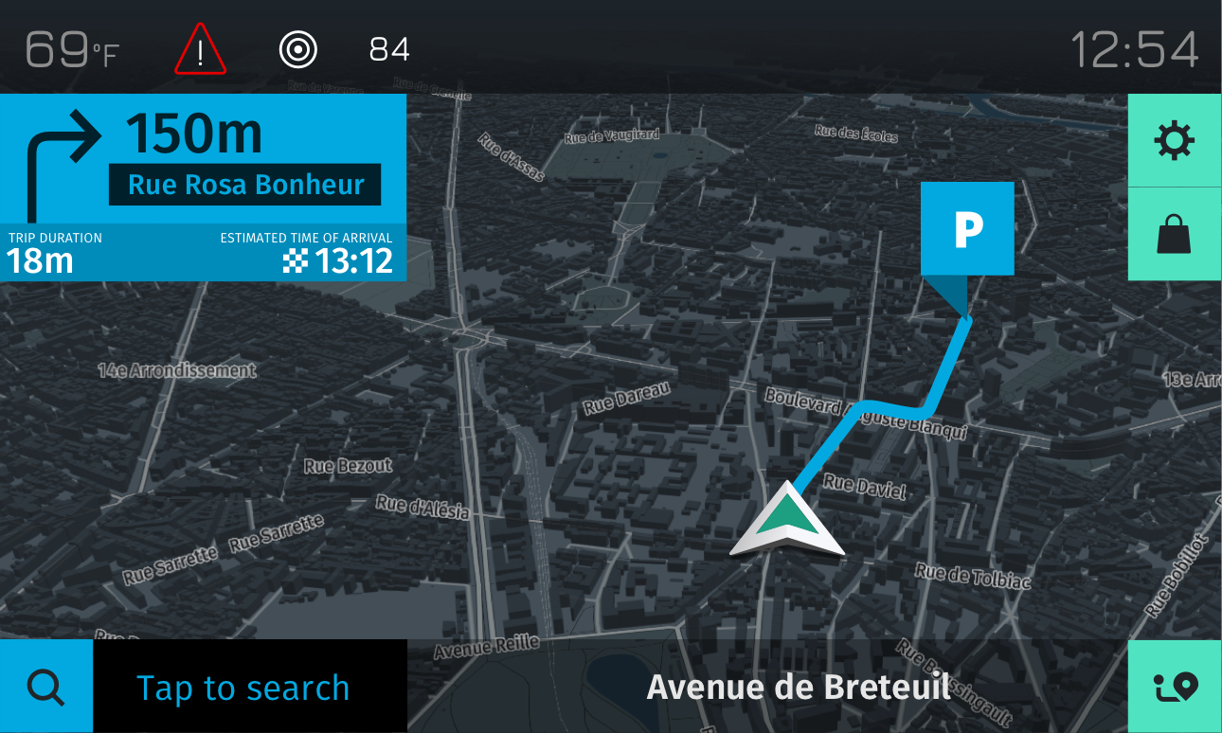
The UX aims at full flexibility through simplicity
Localization
Cards
OEM Branding

Slide 12

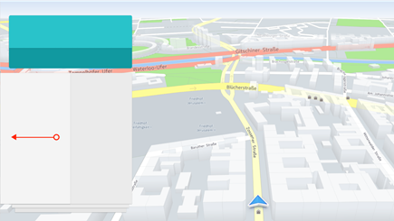
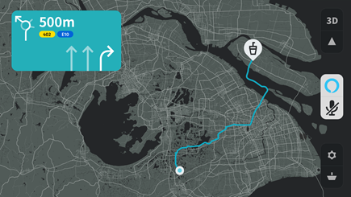
The UX is optimized for a voice-first approach
Pre-integrated
HERE Navigation on Demand and Amazon Alexa
Cards Management
Search
Voice Guidance
“Cards Management”
“Show me Starbucks nearby…”
“In 500m turn right”

Slide 13

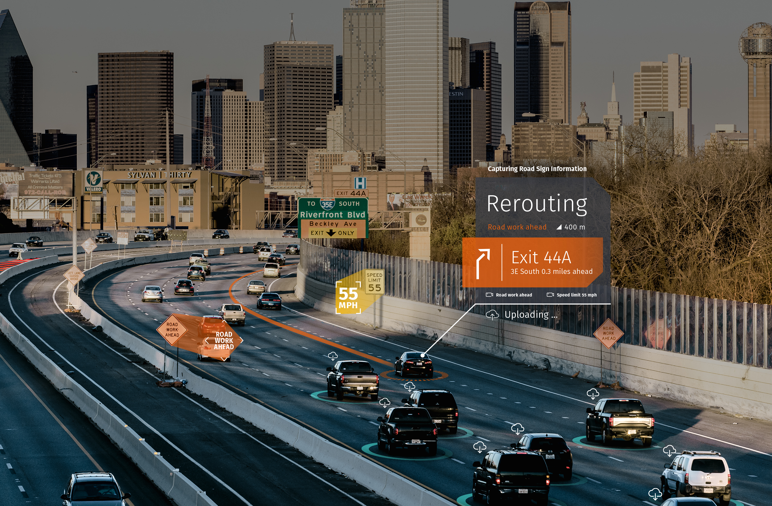
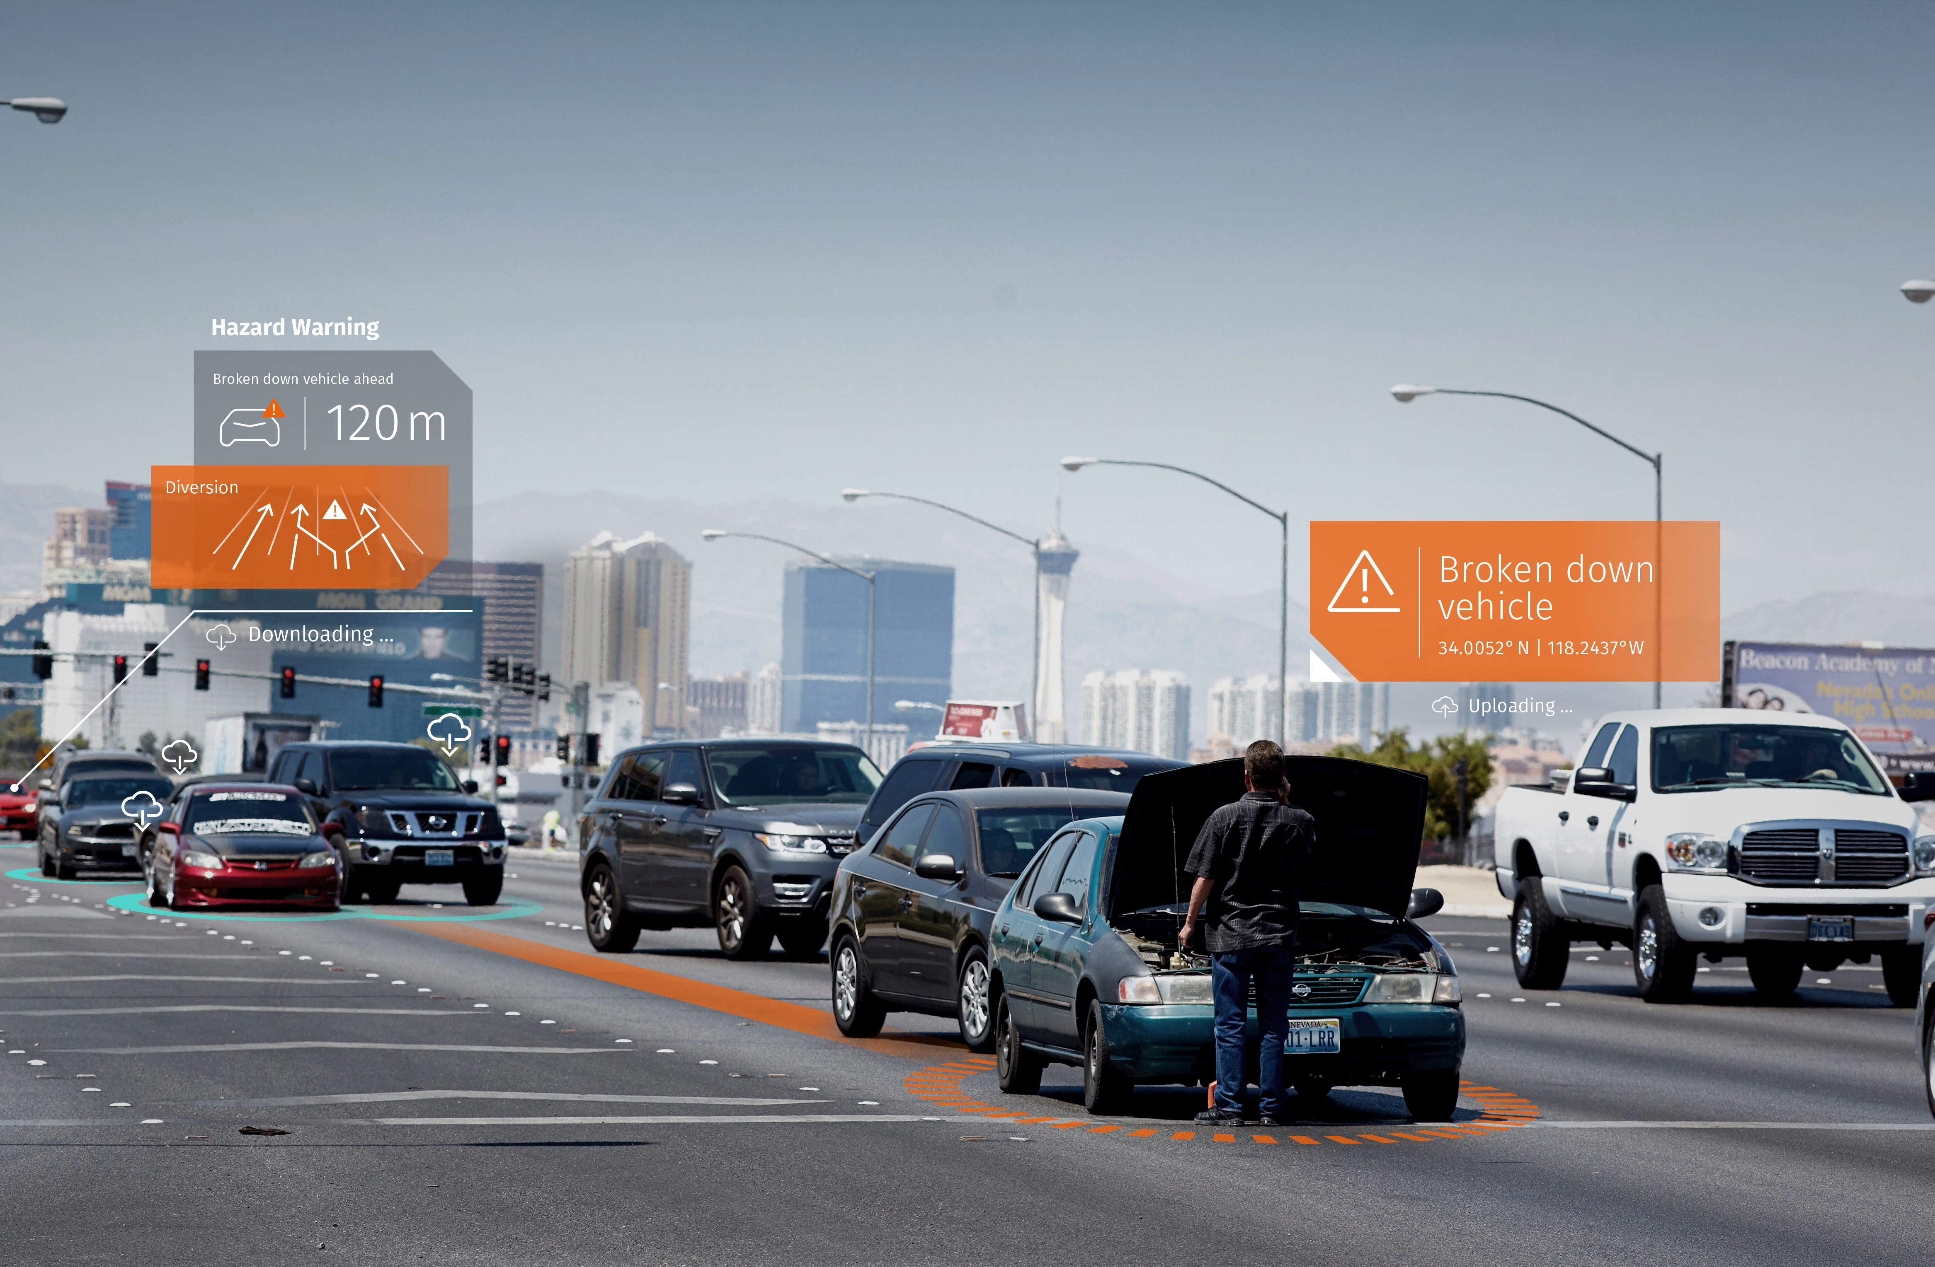


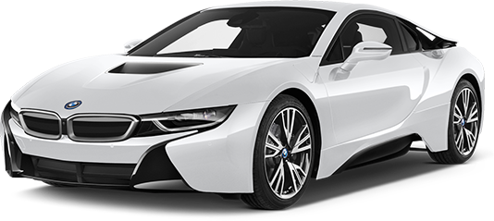
Leveraging access to connected vehicle sensor data to provide real-time road conditions to drivers
Road Sign Validation
Real-Time
Traffic
Hazard Warnings
Video
Data
ABS
Data
Headlight
Data
GPS
Data
Brake
Data
Hazard Light
Data
Ignition
Data
Ultrasonic
Parking Data
Notes:
Navigation & guidance:
The future of navigation is about more than just getting to the destination. It will:
be deeply personal and useful throughout the day, inside and outside of the vehicle
know exactly who’s behind the wheel and anticipate the driver’s needs along the way
provide info to drivers in a way that doesn’t distract them, but instead makes their daily commute safer, more efficient and more enjoyable
Not only are drivers demanding more personalized and innovative experiences behind the wheel – the industry is also asking for more
With the world’s most comprehensive map, our wide range of navigation and guidance solutions that meet the changing needs of the driver, and our high quality Traffic products and services, HERE has the industry covered
The connected vehicle revolution is upon us, and HERE is a one stop shop for location-based services for connected cars – a trusted partner to help develop your offering
HERE Connected Vehicle Services (CVS) combines advanced location analytics, leading software technology, and a driver’s personal preferences to make driving more informed, safer and enjoyable
We offer services for every phase of our journey, including:
Real-Time Traffic
Road Sign Validation
On-Street Parking
Hazard Warnings

Slide 14

Tracking
Solutions
End-to-end
visibility
Lower total cost
of ownership
Indoor and
outdoor tracking
Ground
truth
Gain complete visibility over any object’s journey, no matter where it starts and ends.
Remove cost barriers to entry by optimizing battery consumption and minimizing data transmission costs.
Journeys no longer end
at the door of a building;
you can follow your goods inside instead.
Gain complete visibility by utilizing multiple data sources, such as telematics, trackers and maritime information.
Notes:
Tracking
Gaining visibility and traceability into goods and services as they move through the supply chain is a complex problem. The technology is expensive and outdated, with an over-reliance on manual processes without the ability to optimize in real time.
HERE Technologies' capabilities for end-to-end tracking overcome these legacy barriers through powerful location capabilities that provide real-time information on the status of a shipment, including current location, optimal route, and any sensor data provided by the object tracked.
The increased visibility it brings helps enterprises and logistics managers reduce misplacements and delays as well as minimize production capacity losses and shipping costs. At the same time, they get a solid handle on the ETAs for all their shipments, so they can re-plan capacity in near real time. Visibility into a complete logistics journey enables optimized asset utilization, reduced waste and increased inventory velocity.

Slide 15
HERE has the full suite of tracking capabilities
I’m in the
pick-up area
Location enablers
Measure location of devices and store it on unique basis
React in real time to location changes
Store and analyze location data to control and optimize based on historical patterns
Maps, Venues, Geocoder
Routing, traffic, transit
Positioning indoor and outdoor
Location tracking
Geo-fencing
Notifications
Permanent storage
Location analytics

Slide 16

Advertising
Solutions
Advertising data science beyond nearest POI
Contextual and targeted advertising campaigns
Efficient mobile advertising campaigns
Digital-out-of-Home campaign efficiency
HERE enriches advertising data science with one of the deepest and broadest location portfolios that goes beyond the nearest POI.
HERE’s products give advertisers a rich location context for a deeper understanding of user data, as well as improved accuracy of mobile location signals.
HERE improves audience segmentation, location targeting and campaign attribution. This leads to more efficient mobile advertising campaigns.
HERE helps DOOH companies optimize billboard placement and reach audiences with greater precision.
Notes:
Advertising
In the advertising world, all the talk is around one word: precision. Advertisers need better data and tools to help more precisely target their audiences.
Through the utilization of HERE intelligent location data science, advertisers can increase the precision of audience targeting, efficiency in ad spend, and quality in campaign ROI measurement.
That means less wasted ad spend as well as more relevant and contextual ad campaigns to which people respond.

Slide 17
HERE Advertising Data Services
OUT
Unifies multiple location data sets into
a single interface (REST API)
Enriches user data (lat/long)
with location context
Smart location context
+
3rd party data*
IN
+
Dynamic traffic & weather data*
Matching & Enriching
+
Building shapes
Customer
input lat/long
+
Places

Slide 18
Key takeaways
1
2
3
4
HERE Applications & Services portfolio is expanding to provide unique customer value across diverse industry segments​
HERE Navigation on Demand & Safety Services enable
re-imagined navigation experiences and allow for continued leadership in Automotive
HERE Tracking & Positioning Services provide true
end-to-end visibility across the supply chain – indoor, outdoor, online and offline
HERE Advertising Services empower companies to create advertising campaigns and audience segmentation for their clients

Slide 20
Disclaimer

