Slide 1
Solutions for the future, today Connected, electric and shared mobility solutions

Slide 2
Market demands are forcing OEMs to embrace the future of mobility
From ownership to usership
Changes in mobility behavior and advances in digital technologies are leading to on-demand services
Connectivity and convergence
The car as a digital platform
The digitalization phenomenon enables automotive manufacturer to transform into networked services provider, connecting inside and outside vehicle opportunities
Future of mobility
Safe and smart
Innovating to zero
Vision of creating zero emissions, congestion, accidents and security breaches on the road
Notes:
Market demands are forcing Automotive Manufacturers to change – to evolve.
The car as a digital platform: Digitalization and connectivity enable automotive manufacturer to transform into networked services provider
Enabling promises of new revenues and businesses generation, costs reduction and increase on data driven services: Safety, security, convenience.
Innovating to zero: The pursuit of Vision ZERO: zero emissions, zero congestion and zero accidents on the road.
From ownership to usership: Evolving from ownership models to usership models.
Changes in Mobility behavior
Forcing offerings to converge into a single platform that provides a comprehensive, integrated solution for either domestic or business mobility.

Slide 3
HERE Applications, Solutions and Map & Location Data
… enable an infinite amount of use cases across multiple industry segments
Smart
Cities
Urban Planning
Drone
Navigation
ADAS
Public services workforce Mgt
Public Safety Infor-mation
Call Center Mgt
Network Planning & Optimi-zation
Display
Autonomous
Driving
Emergency Services
Infra-structure
Mgt
Demand Modelling
Ride
Sharing
Automotive
Public Sector
Telco & Utilities
Churn Analysis
Search
Mobility
Data Visuali-zation
Business Intelligence
Navi-gation
Routing
Transport & Logistics
Operations & Planning
Internet & Media
Post Trip
Analysis
Fleet
Planning
Big Data Analytics
Segmentation& Targeting
Tracking
Location Display
Location Analysis
Mobile Dispatch
Truck
Navigation
Notes:
The bredth and depth of our portfolio enables an infinite amount of use cases accross industry segments – both inside and outside of Automotive
The lines between Automotive and other industry segements are blurring
We see transport companies disrupting mobility
Connected cities and the car of the future
Telco‘s through the introduction of 5G
Advent of internet and media – streaming services and targeted advertisements
We strive to be your partner of choice to face disruption and evolve to build the future of mobility, together.
To lead disruption with solutions for the future, today.

Slide 4
Automotive
HERE offers solutions across the Automotive industry – from connected, to electric, to shared mobility
1
2
3
4
Safety
Navigation
EV mobility
New mobility
Notes:
I would like to use this time to focus on 4 key solution areas for Automotive
Safety
Navigation
Electric Mobility
New Mobility

Slide 5
Safety
Automotive

Slide 6
Safety
Industry overview: Challenges
Pursuit of Vision Zero
Incremental approach to HAD
Mass volume market acceptance
Notes:
Safety sits at the intersection of the key trends we spoke about in the introduction.
As discussed market is in pursuit of Vision ZERO.
However at the same time:
The automotive industry is chartered with bringing new technology to cars to enable self-driving functionality. The question of evolution vs. revolution
At the same time, the automotive industry is focused on building trust in consumer acceptance to progressively delegate the driving task to a robot
Safety is a key area of focus to shape the future of our industry.

Slide 7
Safety
Industry needs and HERE differentiators
What the industry wants | How HERE supports industry needs
Improve the performance and convenience of ADAS systems | Augmented lane assistance for improved lateral and longitudinal controls
Future proof for higher SAE Levels | Up-to-the-minute lane level conditions for safety and traffic alerts
Affordable and worldwide scalable solution | Achieving scale with our partners, ingesting rich vehicle sensor data
Notes:
So – what is the market asking for? What does the market require?
Improve performance and convenience of ADAS systems – more intellgience through connectivity
Future proof technology for higher levels of vehicle automation - with path towards autonomous
Affordable and worldwide scalable solution
HERE can support Augmented lane assistance for improved lateral and longitudinal control
HERE can support Up-to-the minute lane level conditions for safety and traffic alerts
HERE can help achieving scale with our partners, ingesting rich vehicle sensor data

Slide 8
Safety
HERE products used
HERE HD Lanes
HERE Hazard Warnings
HERE Road Signs
HERE Real-time Traffic
HERE OLP
HERE HD Lanes
Enhance the visual guidance
Provide visual guidance for consumers by displaying the current car’s position on the correct lane, the planned route on the correct lane, and through intersections. Innovate with augmented reality, with or without heads-up display.
1
2
Improve ADAS functionality Lane positioning of the vehicle to the correct lane, which is currently difficult by sensors only, provides the vehicle with more complete information to improve ADAS feature functionality like lane keeping assist.
3
Go to market faster with seamless integration HD Lanes content is aligned to the SD Map, so it can be used seamlessly in IVI and ADAS applications with detailed lane level content that is high quality and has broad coverage.
Notes:
Our portfolio provides functionality to support a number of safety focused use cases….
I will focus on our HD Lanes offering – a lane level representation of the road network
Lane borders, lane dividers, lane center lines
HD Lanes supports the safety use case through:
Enhanced visual guidance – rendering the lane level map into a visual experience for the driver. Route planning with Augmented Reality or HUD.
Improved ADAS Functionality – lane positioning to enhance ADAS applications like lane keeping assit
Integrated Technology – High def and Standard Def alignment for seamless integration for map referencing

Slide 9
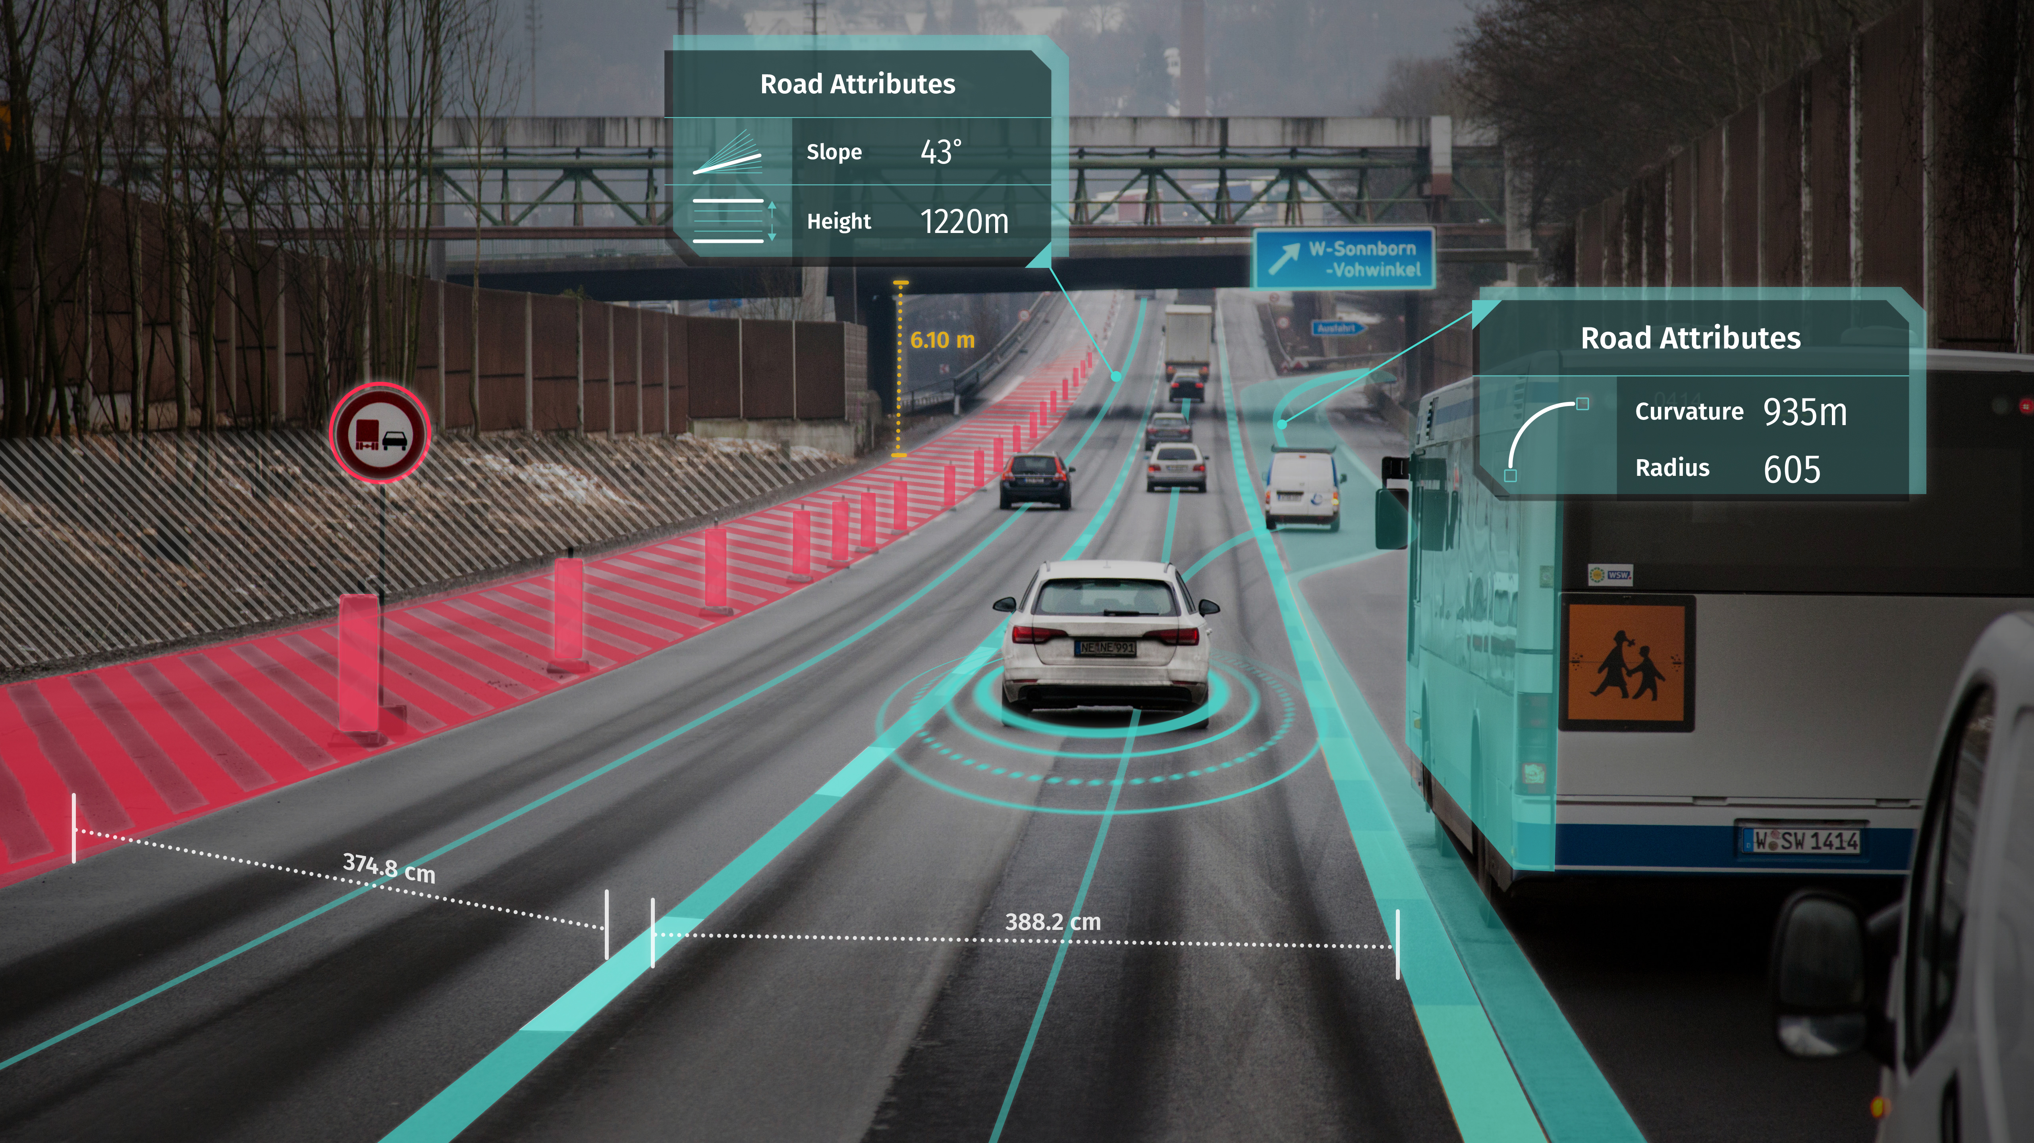
Notes:
Lane width, Lane centerlines, road attributes, lane restrictions, and more
The map attributes allow for diverse functionality supporting use cases from navigation to lower levels of automation.

Slide 10
Navigation
Automotive

Slide 11
Navigation
Industry overview: Challenges
Freshness beyond the map
Unlock recurring revenue streams
Own the user experience
Notes:
The automotive industry faces various challenges when it comes to Navigation:
Freshness beyond map: Always fresh / State-of-the-art UX & functionality / Short update cycles
Unlock revenue streams: On-demand sale of functionality
Own the user experience: Full configurability & branding of the UX

Slide 12
Navigation
Industry needs and HERE differentiators
What the industry wants | How HERE supports industry needs
Mobile-like user experience | OTA update and upgradability of the experience from map database to UX layer – anytime
Enablement of on-demand business models | End-to-end framework for service development and roll-out – including many services from the go
Reduced development and lifecycle cost | Fully integrated, ready-to-port solution allowing for custom functional additions at lower cost
Notes:
To overcome the market challenges, the industry needs to focus on 3 main points:
Mobile-like user experience
Enablement of on-demand business models:
Reduced development & lifecycle cost
HERE can support with OTA update & upgradability of the experience from map database to UX layer - anytim
HERE can support with End-2-end framework for service development and roll out – including many services from the go
HERE can support with fully integrated, ready-to-port solution allowing for custom functional additions at lower cost

Slide 13
Navigation
HERE products used
HERE Navigation on Demand
HERE Hazard Warnings
HERE Road Signs
HERE Connected Services
HERE HD Lanes
HERE OLP
HERE Navigation on Demand
1
Deliver a state-of-the-art UX
SaaS solution for navigation and connected services delivering freshness beyond the map up to UX level, vehicle integrated and cross-device. OEMs can add new functionality anytime.
2
Monetize the IVI, but stay in charge Key services are available as “ready-to-sell” functionality from the start. Build more services with your own data or tap into services from 3rd parties on HNoD’s B2B marketplace. The OEM decides what reaches the vehicle.
3
Achieve global coverage HNoD will gradually become available globally through OneMap Alliance.
Notes:
We have a diverse portfolio that services the navigation use case from a SW, Service and Platform standpoint.
Ultimately, the success of navigation will be on the ecosystem differentiation.
Software as a service solution that allows for freshness and flexibility – from UX to feature integration after SOP
Monetize, but stay in control – control the vehicle experience end-to-end.
Global deployment – a scalable and fully global offering to support platform roll outs across the board

Slide 14
EV mobility
Automotive

Slide 15
EV mobility
Industry overview: Challenges
Boost EV investments and offerings
Mitigate risks of new and fast evolving charging infrastructure
Solution for “experience anxiety”
Notes:
Pursuit of zero emission vision requires the automotive to massively invest into EV powertrain
While at the same time facing the risk of:
New and fast evolving infrastructure and potential fragmentation
And end-consumer facing experience anxiety that a vehicle has insufficient range to reach its destination

Slide 16
EV mobility
Industry needs and HERE differentiators
What the industry wants | How HERE supports industry needs
Global smart connectivity platform | Using a variety of data sources, consumers drive at ease knowing the next charging point is always within reach
An intelligent planner for convenient end-to-end journey | Range map to securely make decisions that are most optimal for the journey
Distinct driving UX for contextualized and efficient route | Flexible offering to enable customized and differentiated EV experience for OEMs
Notes:
To overcome the market challenges, the industry needs to focus on 3 main points:
Global Smart Connectivity platform à the industry needs a global platform to host all EV information so OEMs can ensure their drivers will have ease of mind knowing where all EV stations are
An intelligent planner for convenient E2E journey
Distinct driving UX for contextualized and efficient route – relatable & trusted
HERE can ensure next charging point is always in reach –
HERE can provide, in real-time, a range map to securely make decisions during and before a trip
HERE can offer a flexible offerings for distinct EV experience

Slide 17
EV mobility
HERE products used
HERE EV Charge Points
HERE Auto SDK
HERE Navigation on Demand
HERE Location Suite
HERE OLP
HERE EV Charge Points
1
Eliminate range anxiety
Having the widest coverage, wherever a driver is headed, the service pinpoints any charging stations along their journey and recommends charging stations with the correct type of connector for their electric vehicle.
Give EV drivers information they need Provide all the information drivers need: opening hours, available charger types, brand, number of connectors, subscription, price information and much more. In countries with supporting infrastructure, show drivers in real time which charging facilities have available connectors.
2
3
The most robust coverage and high quality data for EV drivers HERE maintains the quality of its data, ensuring OEMs deliver drivers with reliable and quality information by aggregating data from multiple sources.
Notes:
The HERE EV Charging Stations API is a RESTful service providing drivers with highly granular and up-to-date information about EV charging infrastructure.
Our EV offering sets out to:
Eliminate the consumer anxiety and frustration in range anxiety. Providing confidence to drivers.
As the context changes, drivers need to be aware. Our offering provides dynamic and rich information to drivers to help make informed decisions on charger types, price, availability and more.
Robust and trusted coverage - We have data in over 60 countries worldwide and over 110,000 stations in our database

Slide 18
New mobility
Automotive

Slide 19
New mobility
Industry overview: Challenges
Reliable and flawless usership experiences
Digital and personalized offerings
Cost-effective service development and operations scalability
Notes:
For new mobility, OEMs needs to enable new usership services to face diminishing revenues from car sales and meet new user behavior.
The services needs to deliver multiple and reliable transport options alternative to provide flawless experience to the end user.
In the same time, OEMs will need to hold critical touch points between products, services, hardware and software for data and mobility management in order to offer digital and personalized mobility services offering.
The time is now also to scale activities beyond one pilot, one city, one country to meet operational efficiency.

Slide 20
New mobility
Industry needs and HERE differentiators
What the industry wants | How HERE supports industry needs
Mobility platform with suitable journey options | Highly precise location intelligence for multi- modal mobility experiences
Digital capabilities for valued data services and user profile management | Secured platform environment to support data analytics and monetization
Secure, flexible and worldwide scalable solution | Optimized operations with real-time data at global scale
Notes:
To overcome the market challenges, the industry needs to focus on 3 main points:
Mobility platform with suitable journey options
Digital capabilities for valued data services and personal profile management
Secure, flexible and worldwide scalable solution
Highly precise location intelligence for multi modal mobility – across vehicles, transit, pedestrian experiences
Platform services and data to support analytics and user profile management monetization opportunities
HERE can help optimize operations for asset management, asset tracking with real-time data Global coverage

Slide 21
New mobility
HERE products used
HERE Location Suite
HERE Fleet Services
HERE Mobile SDK
HERE Tracking and Positioning Suite
HERE OLP
HERE Map Data Suite
HERE Location Suite
1
Location-enable your applications
Most credible location service offering on the market, providing ready-to-use functionalities to build up powerful end-to-end solutions, supporting back-end operations, mobile user- and driver-side apps for various functions.
2
Enabling multiple enterprise use cases
To serve customers that want to plan, track, route, assist and analyze the movement of vehicles or people. To feed activity and operations data to OLP, in order to create valuable new insights, services and analytics.
3
Global coverage
HERE LS is available in 223 countries globally*.
*Availability of services varies by country
Notes:
We have broad portfolio reach to support mobility solutions within the Automotive industry…
Location enable front-end applications and back-end to improve user satisfaction and operational efficiencies
We can provide location APIs such as routing, geofencing and tracking APIs to support enterprise use cases for fleet planning, tracking, routing and analysis
HERE Location Services is available in 223 countries globally*
HERE Location Services in Japan in 2019

Slide 22
Key takeaways
1
2
3
HERE brings solutions that support key industry needs around the connected, shared, electric and automated vehicle​
HERE provides solutions for our partners which are future proof, enabling shorter, more efficient and suitable innovation cycles
HERE enables our partners to cost-effectively manage operations and deployment globally
Notes:
HERE brings solutions that support key industry needs around the connected, shared, electric and automated vehicle
HERE provides solutions for our partners which are future proof, enabling shorter, more efficient and suitable innovation cycle
HERE enable our partners to cost effectively manage operations and deployment globally

Slide 24
Disclaimer

