Slide 1
Open Location Platform business and product update

Slide 2
The HERE Open Location Platform (OLP)
We built OLP and put it in the hands of different customers across the globe. The Platform for Location Intelligence.
Notes:
What is the HERE Open Location Platform?
One system for data exchange plus data enrichment. Powered by Location Intelligence

Slide 3
Agenda
1
2
3
What is OLP
Strategy Refresh
Path Forward

Slide 4
Why OLP?
Facilitate & simplify complex value chains centered on extracting value through location intelligence
Match supply & demand for:
Data Services & Algorithms Applications
Simplify access to location data products, services & applications by standardizing APIs + IAM (Identity Access Management)
Simplify buying by standardizing business terms

Slide 5
What is OLP?
Build
Exchange
Reality Index
Workspace
Marketplace
Developer tools, analytics, data management and scaled-out processing plus access to HERE data
Neutral and scalable marketplace enabling secure and controlled data exchange
Notes:
OLP consists of the Development Environment where developers can enrich their own data and create value-added products. On the other side we have the Marketplace to get access to third party data from others as well as sell your own data.

Slide 6
OLP Workspace
Accelerating new product/service development that leverages location intelligence
Local computer
OLP Cloud
OLP Software Development Kit
OLP SDK downloaded from OLP Cloud to developer’s local computer

Slide 7
OLP design
It abstracts the complexity of underlying engineering components to provide an end-to-end canonical user journey
What the user does
What the user gets
 | Account management | Data access & ingestion | Data analysis | Data processing | Data distribution
Portal
Data
Pipeline
SDK
Notebook
Reality Index
Portal
Data
Pipelines
User-created
Stream layer
Volatile layer
Versioned layer
Stream
Schemas
Notebooks
Schemas
Location libraries
Schema tool
SDK
Command line interface
Platform Security
Plattform-provided
Data API
Pipeline API
API´s
HERE Data
Reality Index

Slide 8
OLP Workspace typical usage
OLP Portal
AAA
Logging & telemetry
Pipeline management
Deployment
Raw input data
Readable input data
Processed output data
Data input
Ingestion
Data service
Ex: Streaming
Pipeline
Data service
Ex: Volatile
Data output
Local computer
Rendering
OLP SDK
(SW code = JAR* file)

Slide 9
OLP Marketplace typical usage
Solution Provider
OLP Workspace & Marketplace
Raw data
HERE curated, enriched data
Data Pool
App/Solution
Marketplace Provider
Marketplace Consumer
Value Enhancement

Slide 10
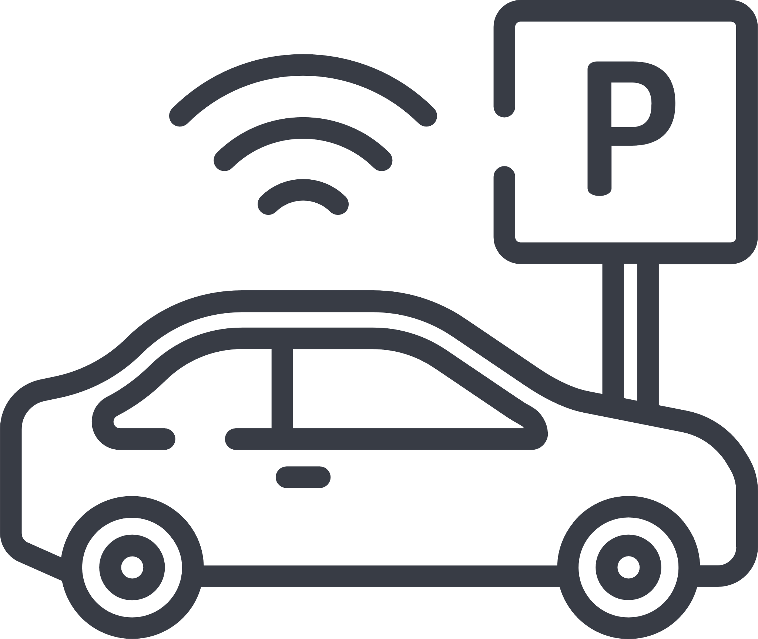
OLP examples
IoT-related use cases
Automotive-related use cases
Smart cities solutions
After-market services
Power and utility solutions
Predictive maintenance
Custom HD Live Map layers
Road friction/ Pothole service
Advertisement
Pollution monitoring
Usage-based insurance
Connected vehicle
Real example on next slides
Notes:
Smart cities solutions
Road Asset Management
Potholes, road roughness
Traffic management
Infrastructure sensor harvesting
Traffic lights optimization
After-market services
Optimize after market services for IoT equipment
Adjust maintenance service level based on error code level
Flexible resource management based on network status
Optimized navigation routes
Home Automation settings based on “my” location
Power and utility solutions
Balance demand-response for energy consumption
Combine EV & Home appliances information
Network peak shaving
Advertisement
Billboard ads based on pedestrians and POI
Traffic-based couponing (vehicles, pedestrians)
Analytics on spending capacity based on location
Pollution monitoring
Cities monitoring and analyzing emission levels in cities based on traffic, weather and other factors
Ability to re-route traffic based on emission levels in cities
Combine monitoring with pro-active management of public transportation and associated offers
Predictive Maintenance
Monitor vehicle/fleet health using embedded sensors
Extract information on vehicle status
Discover, analyze and highlight potential maintenance needs
Improve vehicle health, avoid recalls and increase customer satisfaction
Custom HD Live Map Layers
Create custom layers for autonomous driving as HD Live Map is a standard service for enabling autonomous driving (SAEL3/4)
Tailor HD Live Map to specific vehicle/fleet needs or use-cases
Create USP by tailoring HAD to customer needs
Road Friction/Pothole Service
Develop a service that provide road friction information and pothole detection to vehicles and eg cities
Crowd sourced vehicle data to analyze roads in near-realtime
Provides warning on dangerous road segments, eg for ADAS/HAD use-cases
Allows smoother rides through pro-active suspension modes
Lets cities better leverage road clearance services and deter-mine which roads to fix first
Usage Based Insurance
Monitor and analyze driving patterns on anonymous or personalized level
Determine dangerous areas for speeding/accidents
Improve insurance products and offer customized premiums
Connected vehicle
Safety related scenarios
Hazard warning
On-street parking
EV charging info

Slide 11
Animal on Roadway Detection Application to Improve Road Safety
Step-by-step build of application leveraging HERE OLP
Ebersberger Forest is a region in Germany where many of the roads pass through forest areas
Lots of accidents
Very dangerous
Local authorities formed a consortium with key car manufacturers to develop an application that may provide real-time warning to drivers concerning animals on the roads
Real-time observations are fused with historical learnings, HERE map content as well as HERE Weather and Traffic content

Slide 12
Step 1 of 6: Bring your own data (BYOD) and start exploring
The Ebersberger county uploads historical data directly in OLP Workspace or they can import from OLP Marketplace that has all the observations from cars in the forest over the past several months
This allows data scientists to start analyzing data using HERE XYZ for visual analytics and/or HERE OLP analytics and machine learning (ML) tools to determine the best approach and ML algorithms
Market-place
Sensor
archive
1
1
Market-place

Slide 13
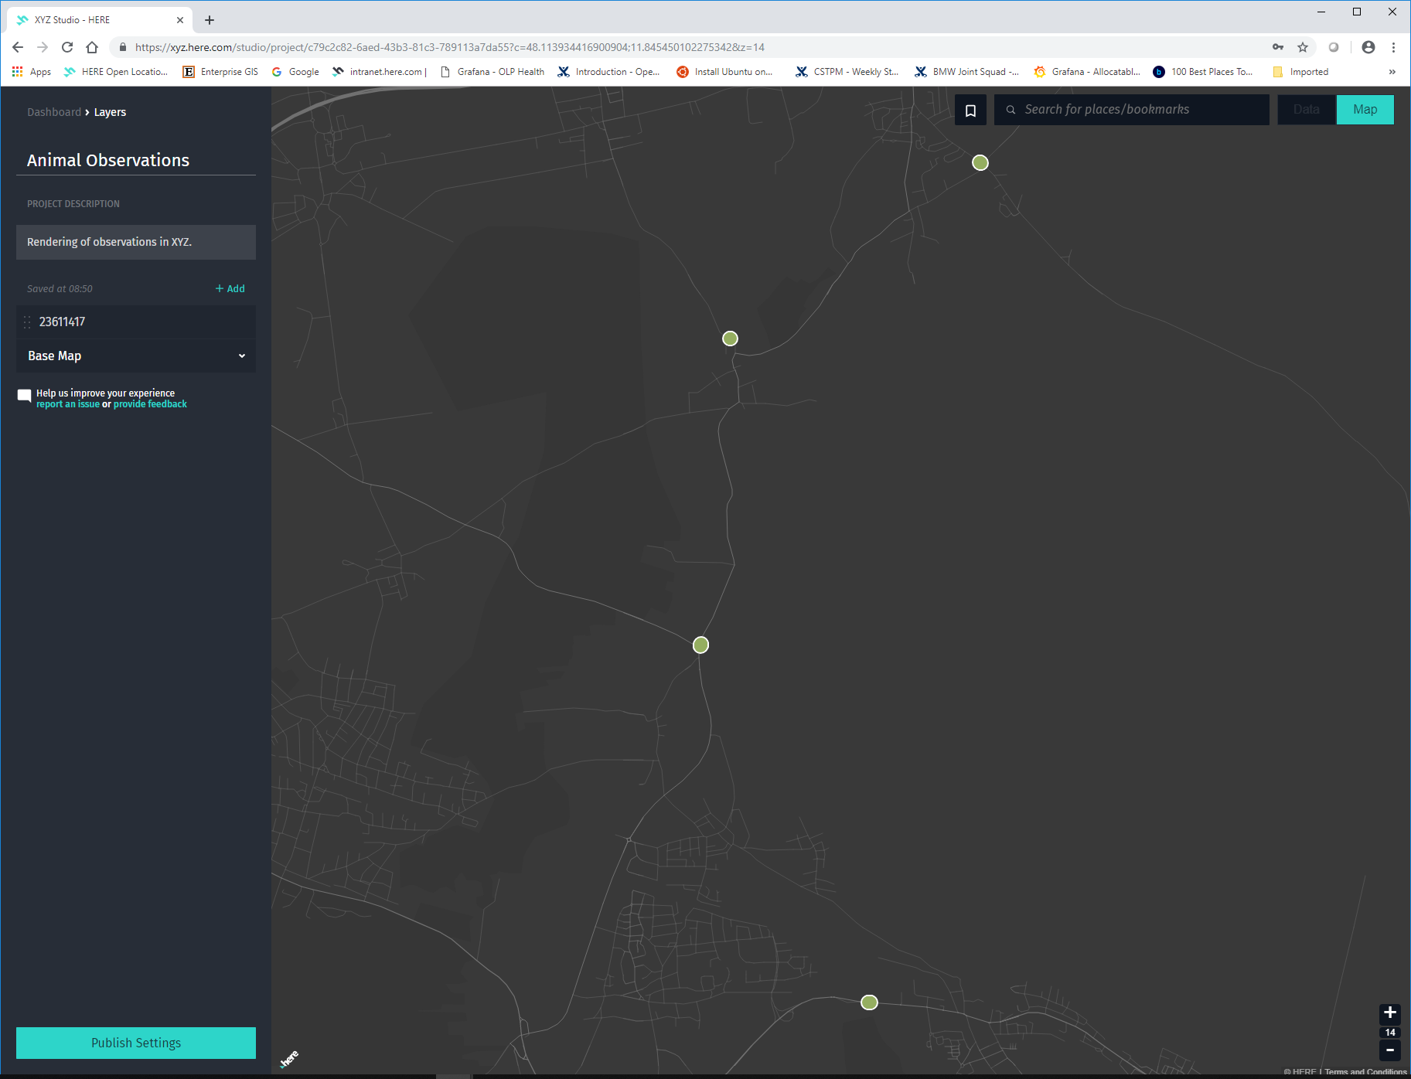
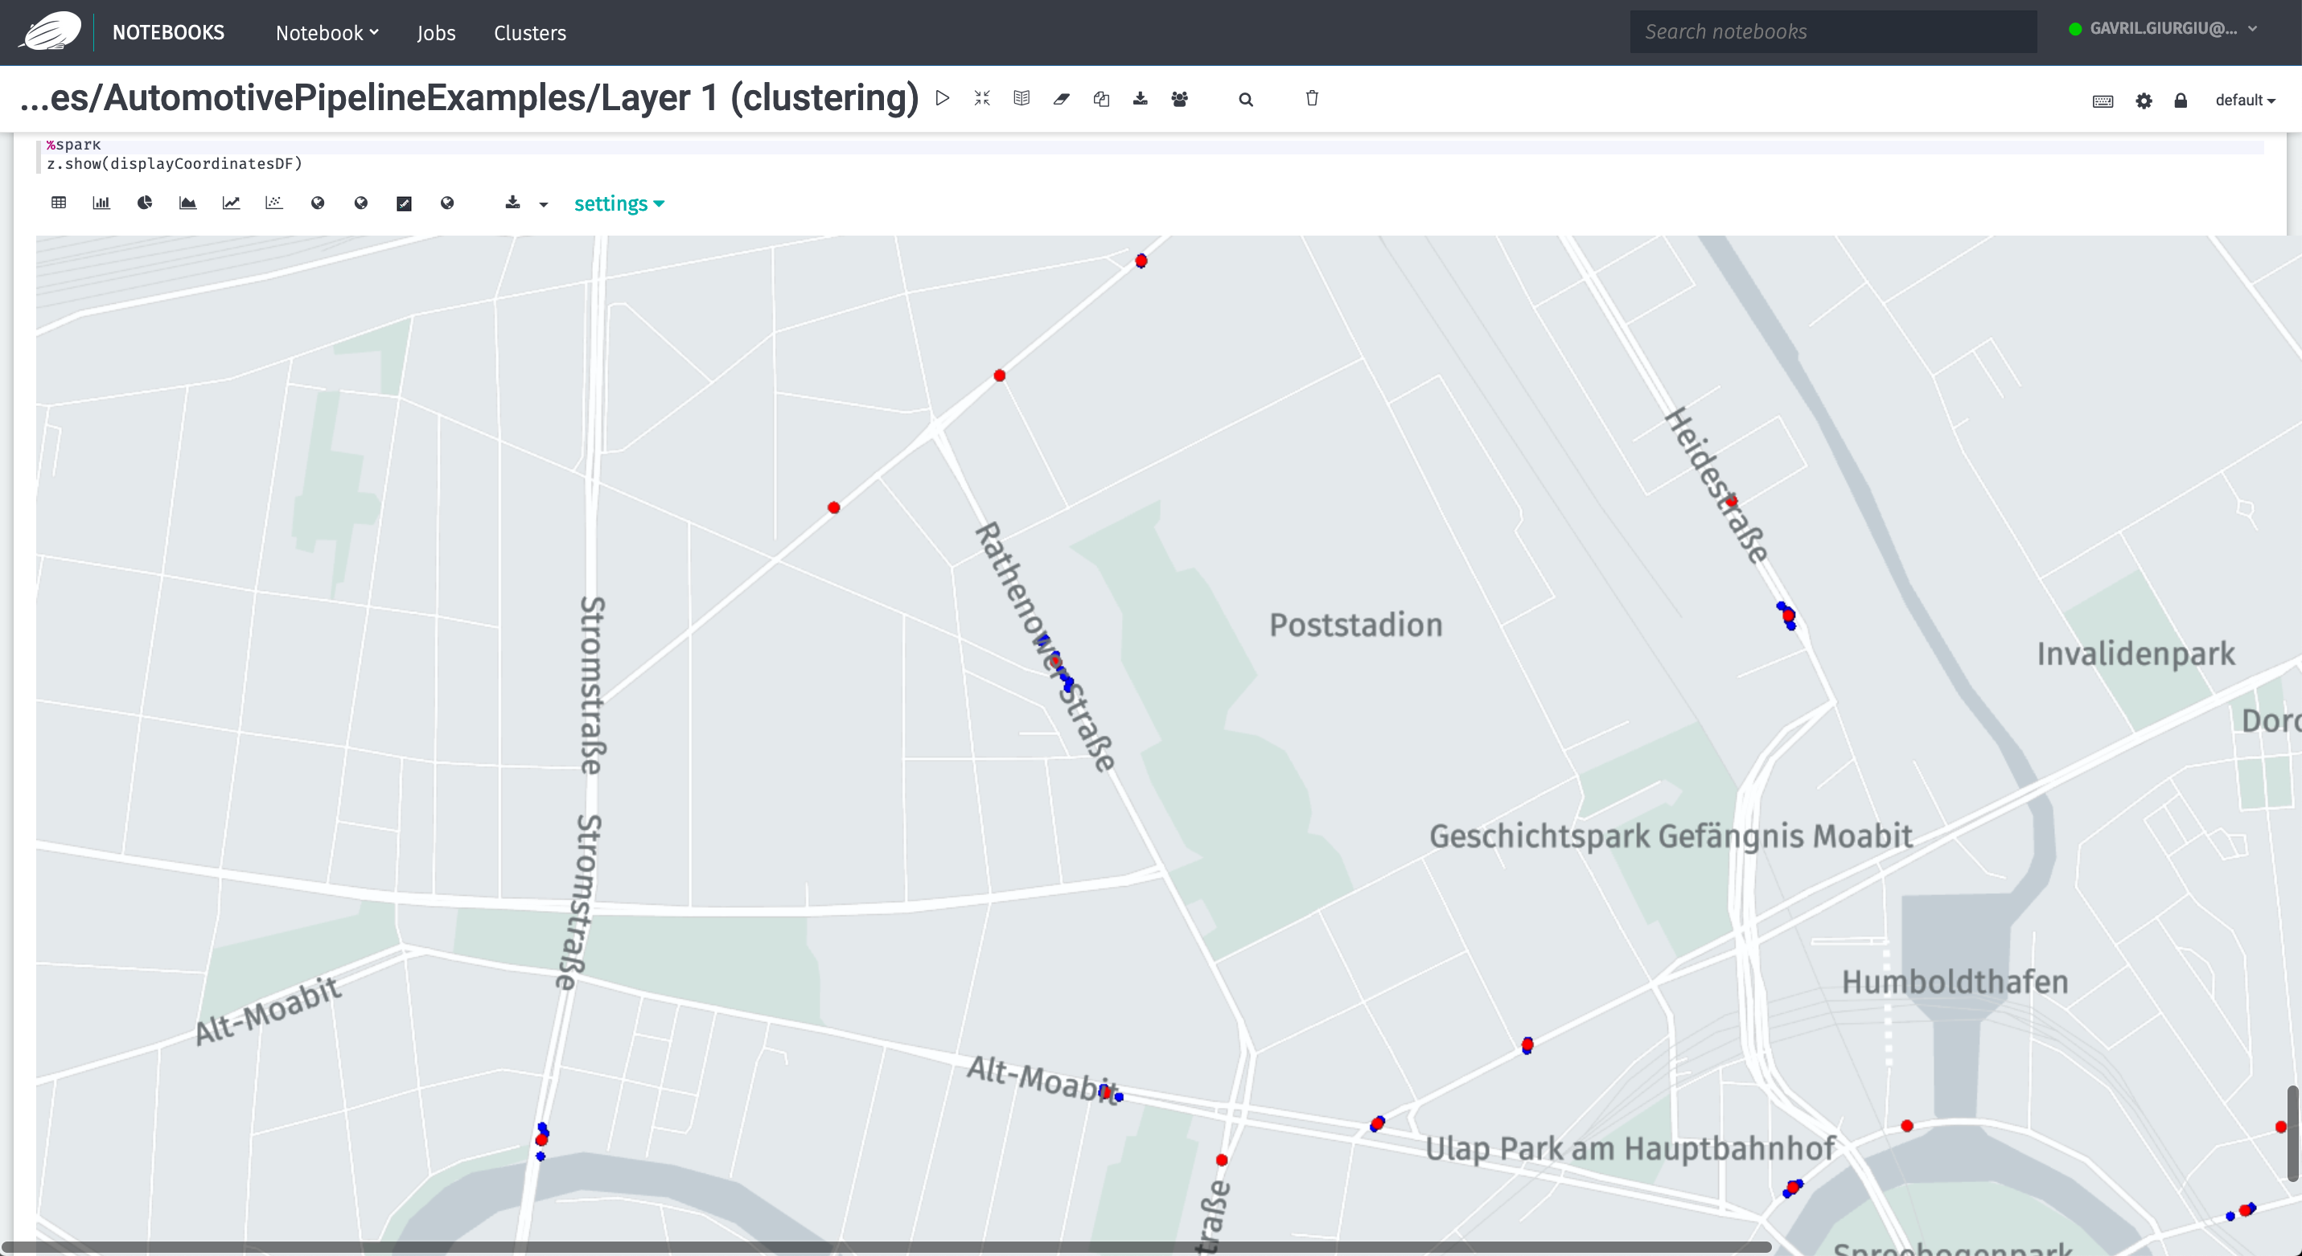
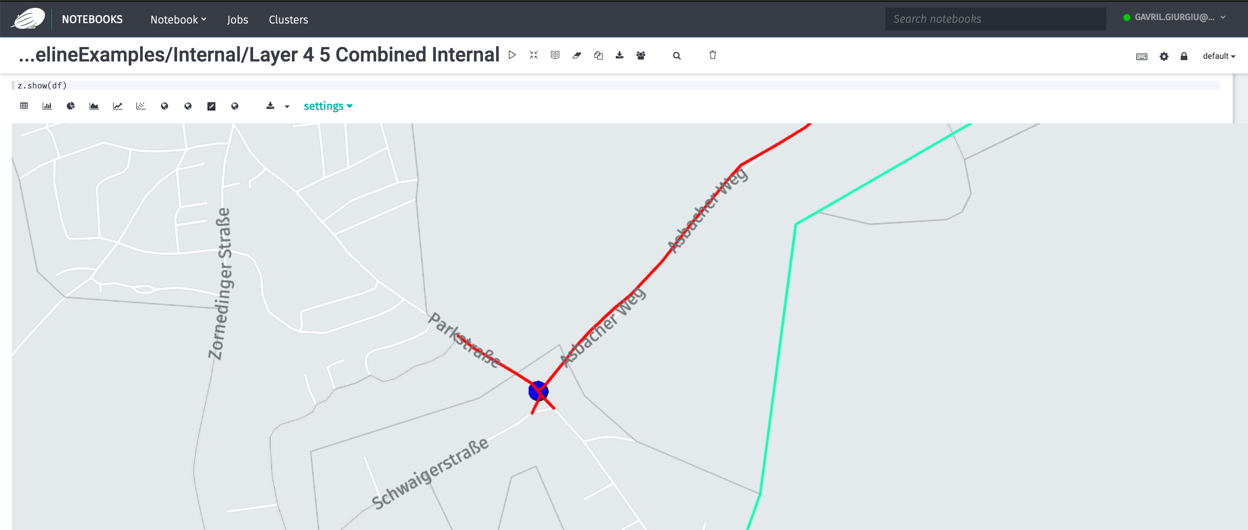
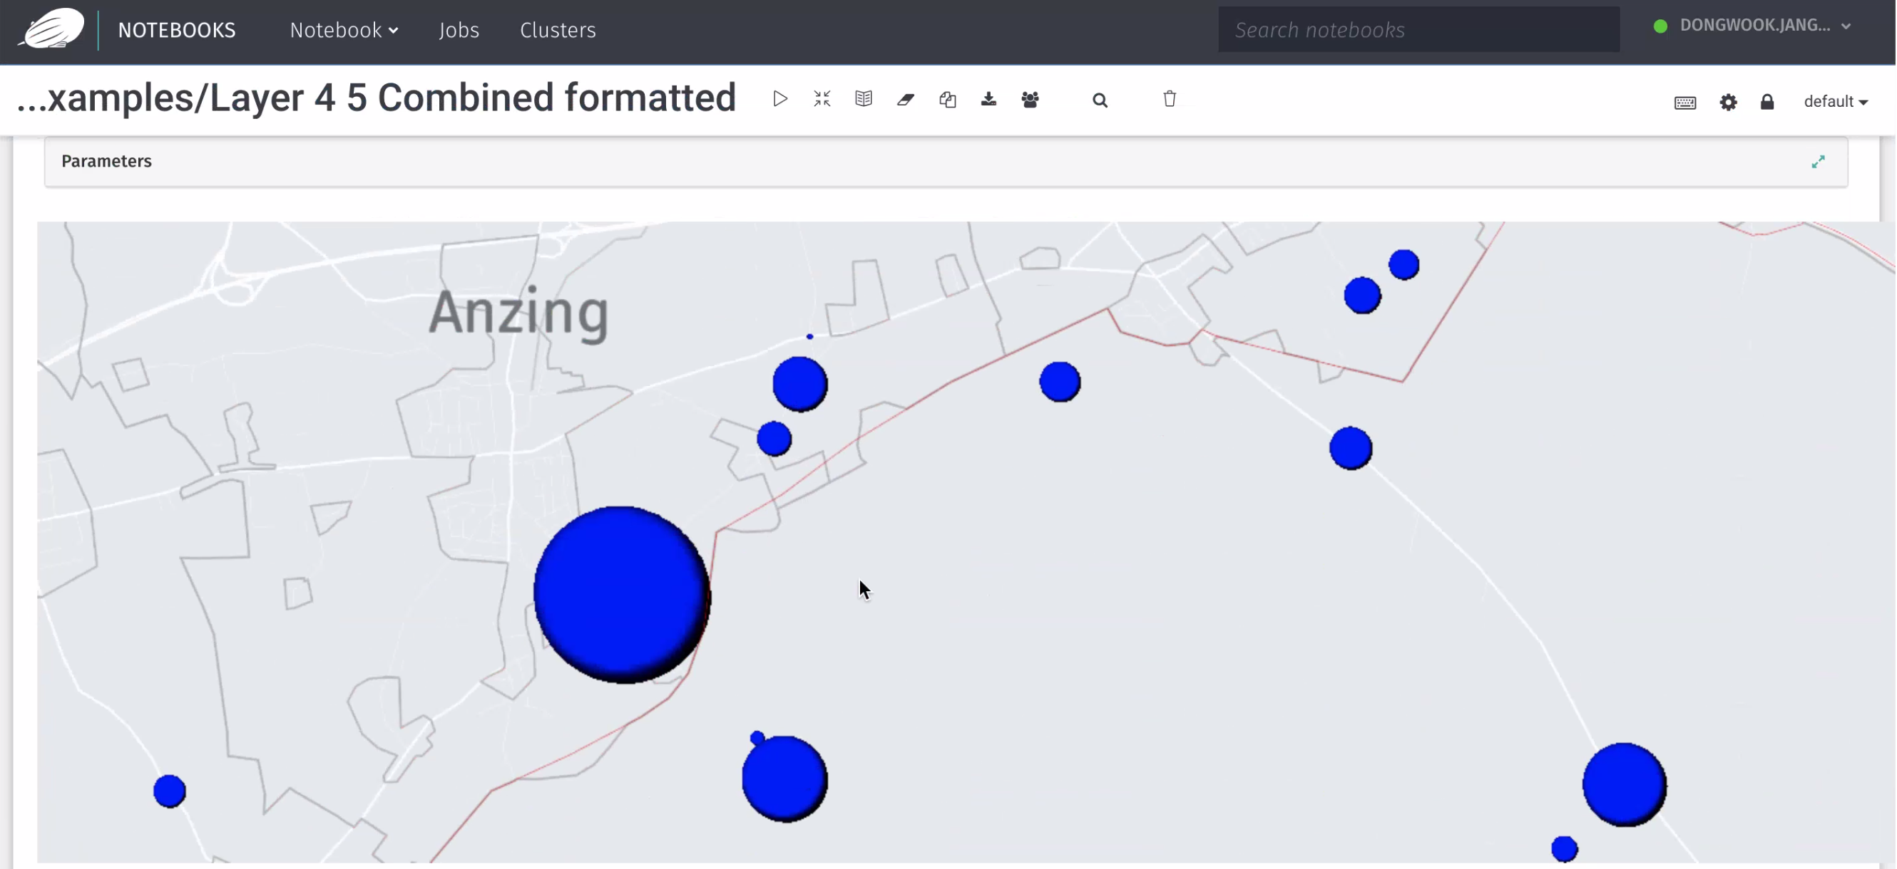
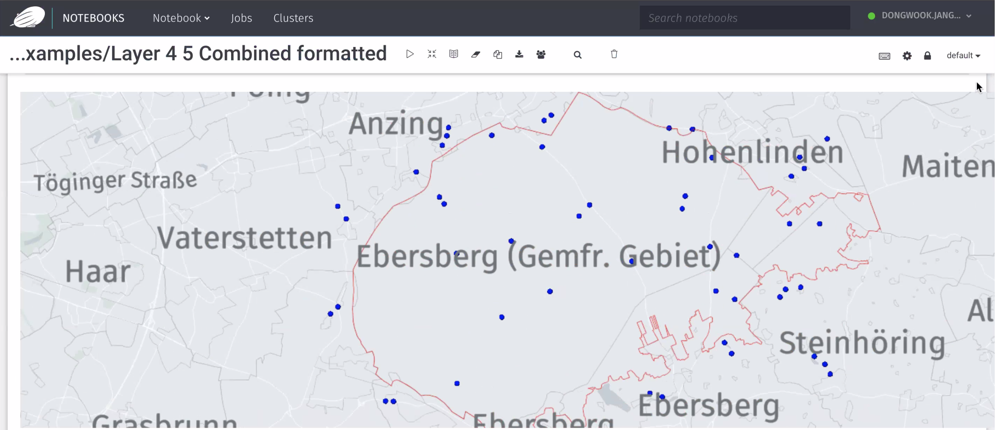
Animal on Roadway Detection – Data Analysis and Visualization

Slide 14
Step 2 of 6: Data ingestion of real-time sensor data
Sensor messages are sent to OLP in real time
Data contains drives and animal-on-the-road sightings in and around Ebersberger Forest
Input data
Raw sensor
2
Market-place
Sensor
archive
1
1
Market-place

Slide 15
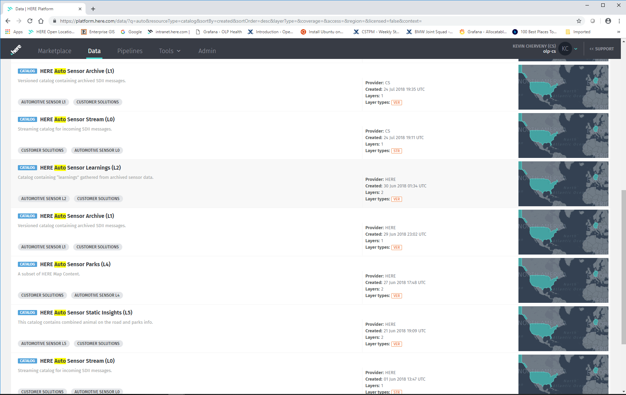
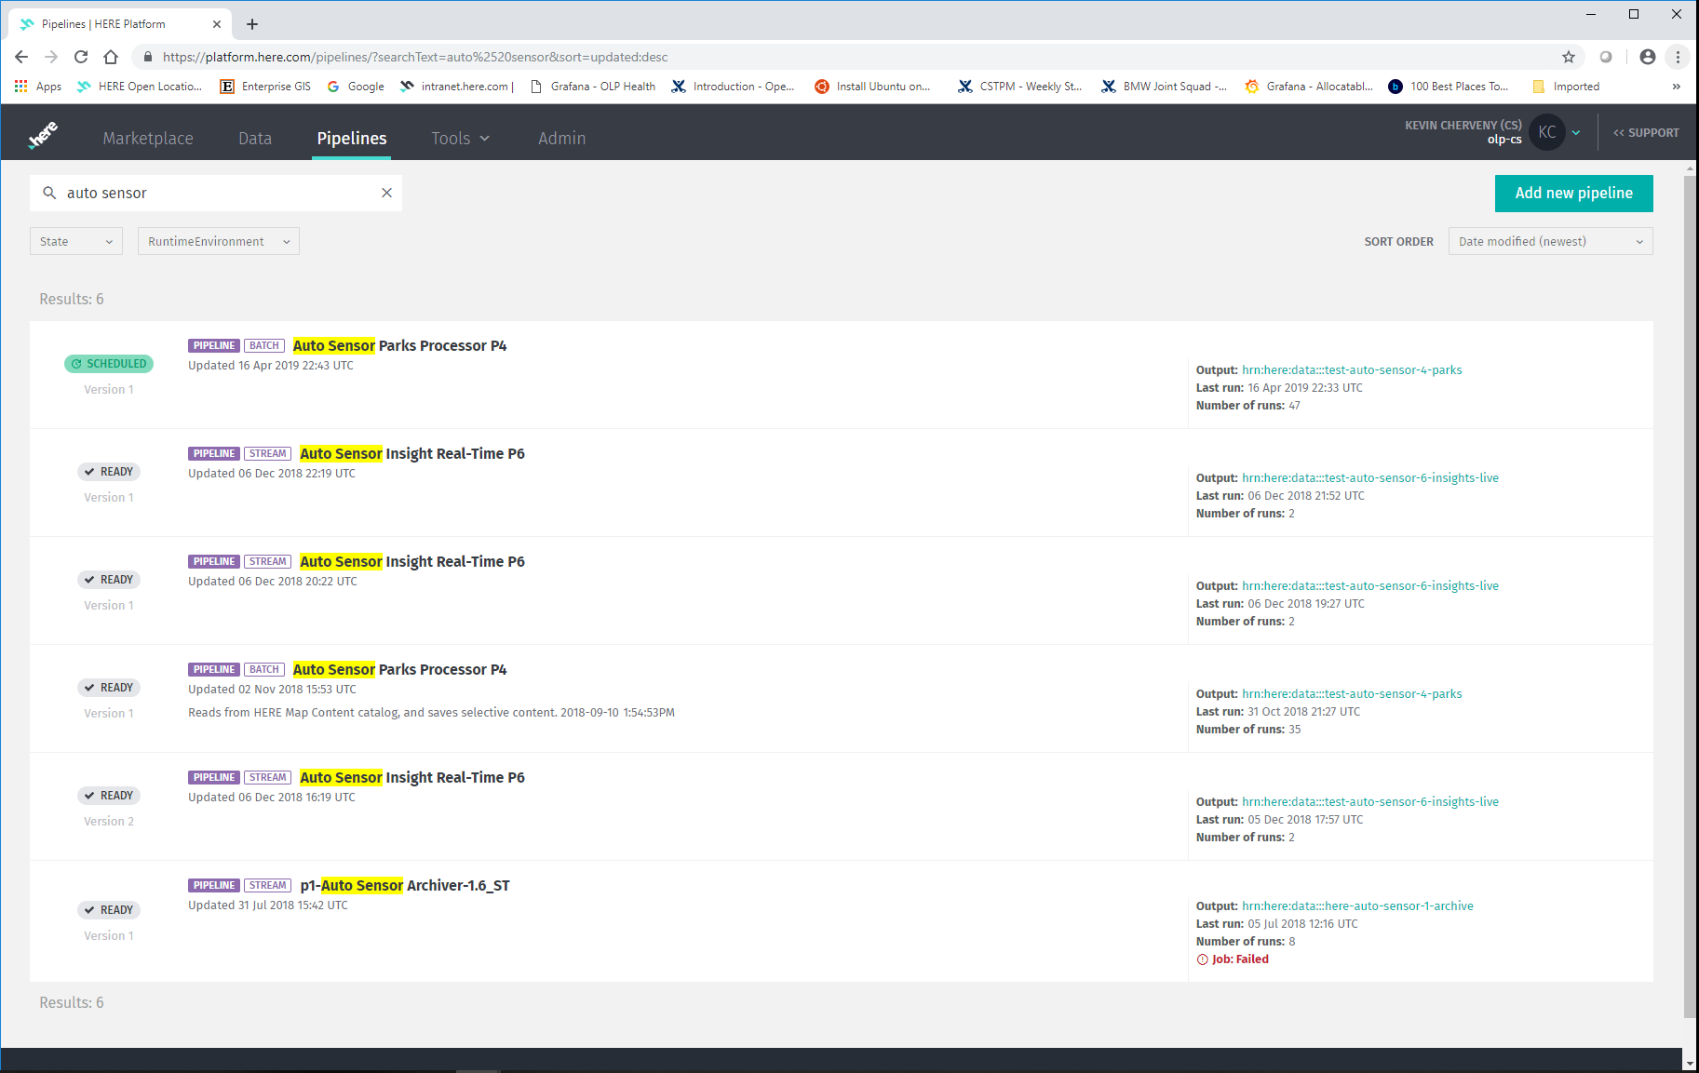
Animal on Roadway Detection – Sensor Data Processing and Catalogs

Slide 16
Step 3 of 6: Data processing using ML models
Customer value
processor
Output of the Raw Sensor Streaming Catalog is fed into two (2) processing pipelines
Archive Processor saves all incoming messages by time and tile
Customer Value Processor computes animal-on-the-road warning levels based on real-time and historical observations
Input data
Raw sensor
Customer value
2
3
3
Sensor Data Archiving
Ingested Sensor messages are stored in an archive storage
Sensor messages are queued and saved at hourly intervals partitioned by time received and tile of message origin
Archive is expected to grow significantly over time
Sensor data can be searched and retrieved by any/all of the following three dimensions: Location, Time, and Event Type
3
Data Science & Research
Data Scientists develop ML models and algorithms from sensor data
ML models and algorithms are provided to Data Engineers to code and implement into processing pipelines
Market-place
Sensor
archive
Archive
processor
1
3
1
Market-place

Slide 17
Step 4 of 6: Derive learnings
Customer value
processor
Processing in the Sensor Learning Pipeline involves
Processed weekly, monthly, seasonal, and by time of day
Archive learnings of where animals on roadways typically show up are enhanced by the Reality Index base (aka HERE Map) including Traffic and Weather content
Input data
Raw sensor
Customer value
2
3
3
3
Market-place
Sensor
archive
Archive
processor
Reality Index base
1
3
1
4
Market-place
Archive
processor
4
Sensor learning

Slide 18
Step 5 of 6: Closing the loop
Customer value
processor
Narrowed RIB catalog is used to save pre-processed and transformed HERE content
Limits the amount of Pipeline processing performed directly on the RIB, and pre-calculate Customer-specific value
Refine our historical learnings
Map Match all cluster centroids using the Location Library
Filter the map matched clustered observations to the road segments in and around the park
Input data
Raw sensor
Customer value
2
3
3
3
5
Market-place
Sensor
archive
Archive
processor
Customer
static value
Reality Index base
1
3
1
4
5
5
Market-place
Archive
processor
Sensor value
processor
Narrow RIB
RIB
processor
4
5
5
5
Sensor learning

Slide 19
Step 6 (final step): Cloud-to-edge connection
Customer value
processor
OTA agent
Thru OTA agent the application is provided to all the cars so when they cross the forest they may have the right warnings
Input data
Raw sensor
Customer value
External application
2
3
3
6
3
5
Market-place
Sensor
archive
Archive
processor
Customer
static value
Reality Index base
1
3
1
4
5
5
Market-place
Archive
processor
Sensor value
processor
Narrow RIB
RIB
processor
4
5
5
5
Sensor learning

Slide 20
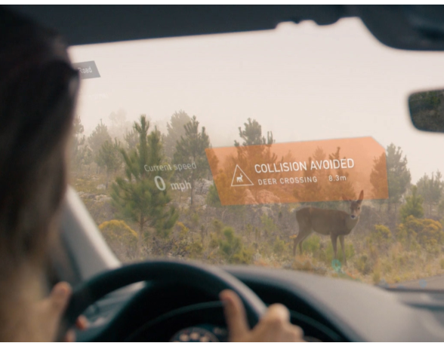

Slide 21
Agenda
1
2
3
What is OLP
Strategy Refresh
Path Forward

Slide 22
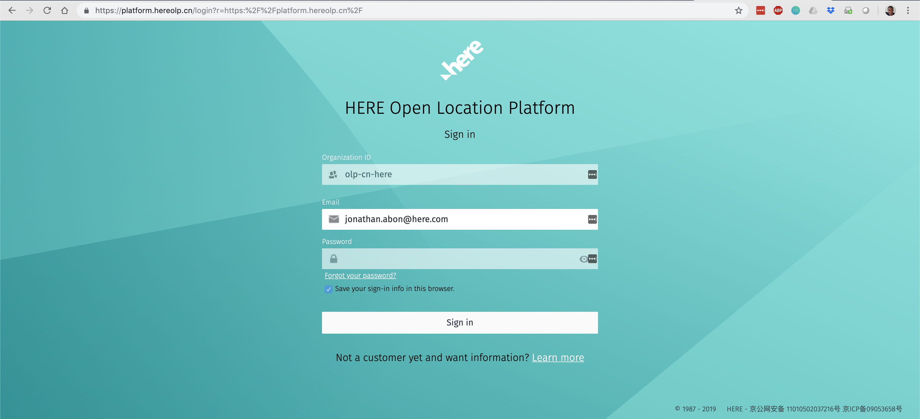
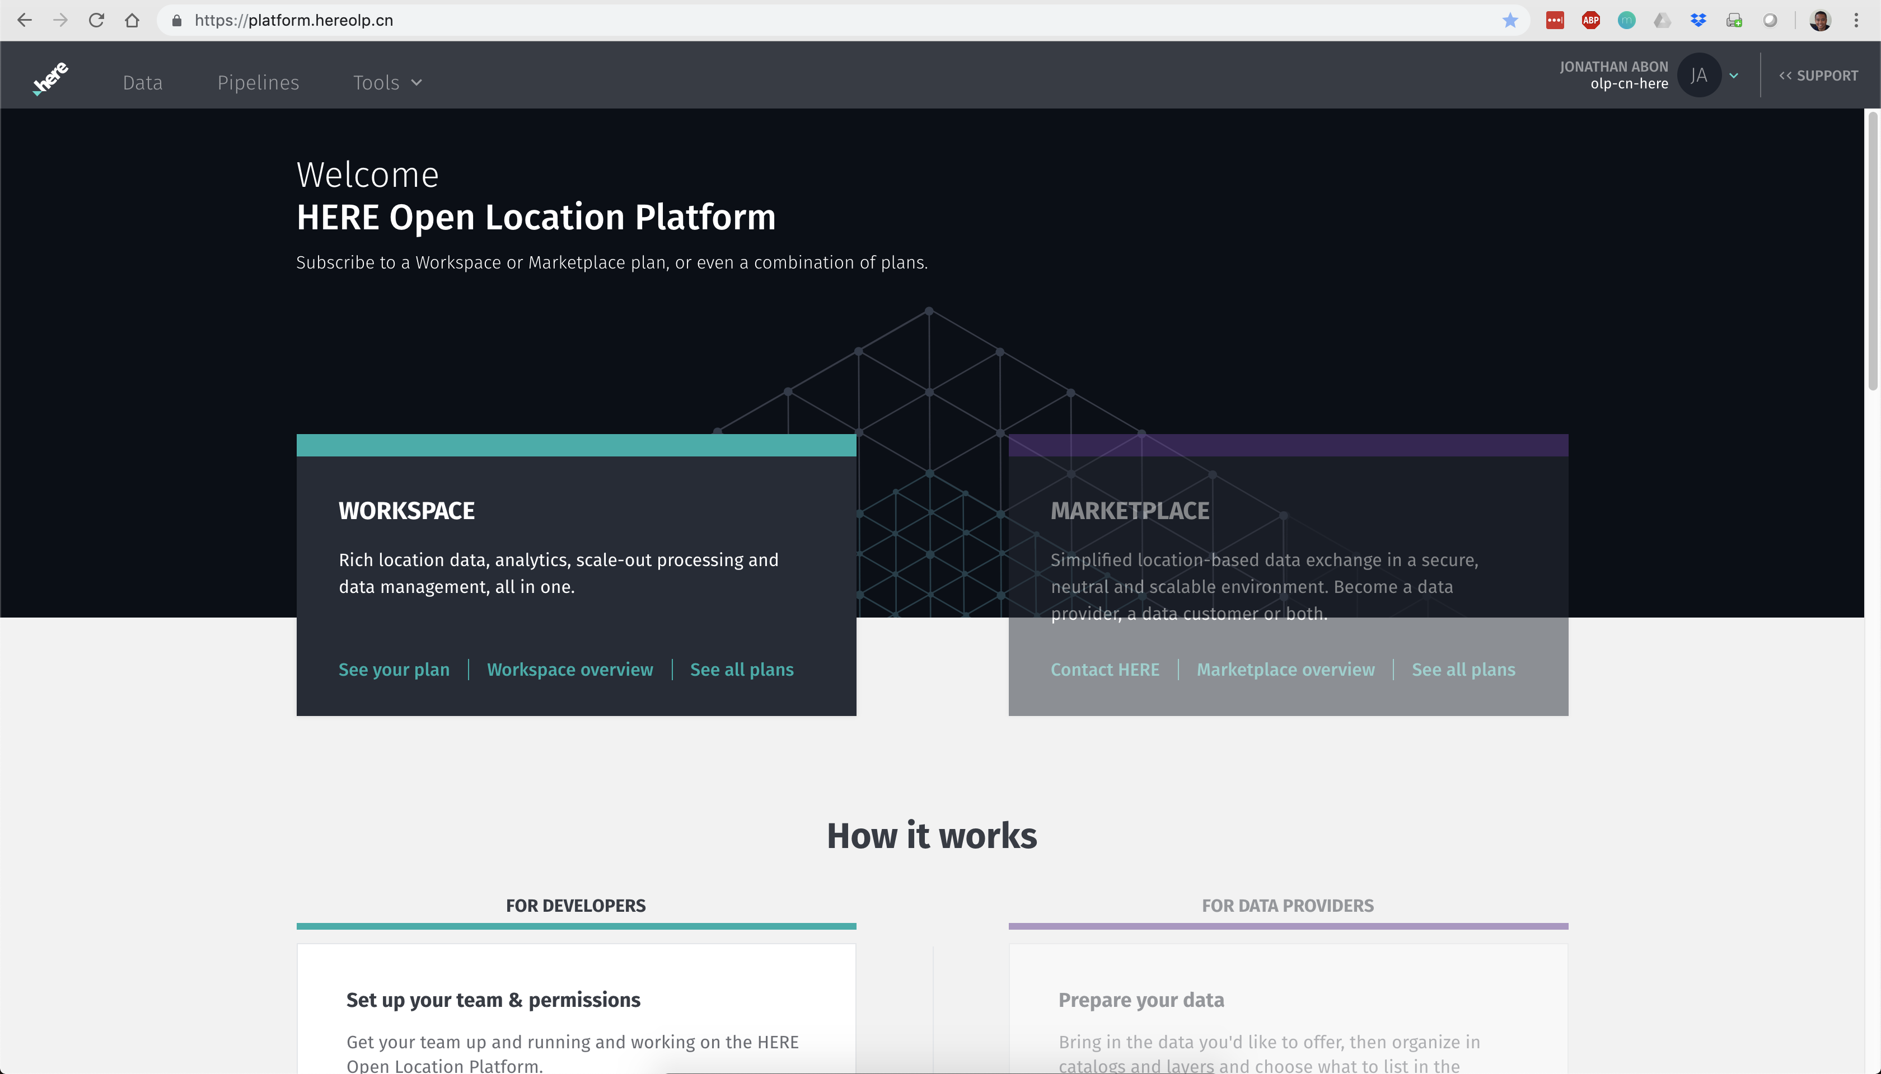
OLP 2.1 launched
in China Dec 2018 (https://platform.hereolp.cn)
Deployed OLP in China Already working with three (3) customers to utilize OLP global footprint, including China

Slide 23
How open is “Open”?
Any location data, service and application provider or consumer can participate in the OLP ecosystem
OLP team is actively pursuing partnerships with “coopetitors” – cooperation with businesses that might be competitive with other HERE businesságroups
No special treatment for other HERE business groups – same feature set as all other customers
Support data in any format – even though this flexibility can add some complexity
Plan to make all HERE data and services assets available with transparent, transaction-based pricing
Working to strike the right balance between openness and HERE value-add

Slide 24
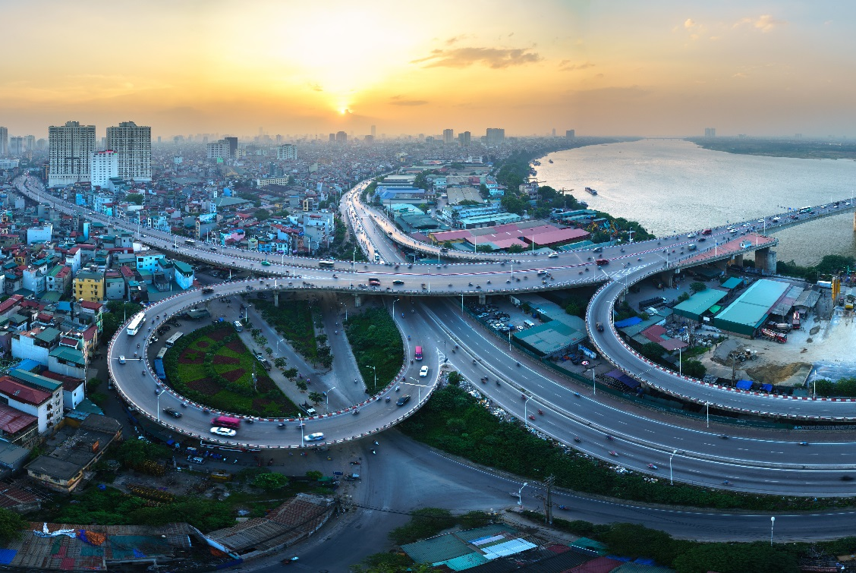
Why “Location”?
Proliferation of geo-tagged data available with emergence of connected and autonomous devices
Highest-quality global map available for processing/enrichment
Customer-provided processing logic can run close to the data center of gravity
Out-of-the-box support for map matching (stream and batch)
More out-of-the-box capabilities needed to accelerate customer success
Additional location processing/enrichment functions
Simplified access to the map data
Better ways to spatially align and associate disparate data sources
Difficult to acquire and make sense of location-based data
HERE has a long legacy of acquiring and processing location-based data – it’s our core competency

Slide 25
What makes it a “Platform”
HERE is seeding the ecosystem with data, algorithms and services
Initial focus on “single-player mode” – enabling participants to build end-to-end value for themselves
Need to partner closely with early adopters to evolve capabilities
Core enablers built to allow participants to “choose their own adventure” – discovering new possibilities for value creation and monetization
Need to add support for “Bring Your Own Service” – to enable Service Providers and Developers
OLP Workspace
Developer-oriented platform technology
Focus on developing your value-added business logic
Cloud-based managed services to reduce operational overhead
OLP Marketplace
Multi-sided platform business model
Ecosystem facilitating interactions between Data Providers, Data Consumers, and Developers
Foundational pay-as-you-go, transaction-based pricing

Slide 26
OLP value pillars
HERE Data
Rich and global map content
Highly accurate and fresh
More variety with expanding coverage HERE Real-time Traffic data HERE live, archived and forecast weather data HERE HD map
HERE Location Tools
Industry-leading location tools based on our industry known expertise Map Matcher Geospatial Clustering Open Location Services (OLS)
More accurate and efficient
Always reflects the latest state of research
Commitment to add more value with respect to location enrichment
Optimized Map for Analytics (OMA) with visual analytics and machine learning libraries
HERE Marketplace
Sellers: Ready to use infrastructure to offer and sell your product in a private or public marketplace environment Opportunity to participate in larger scale data pools and products offered by HERE
Buyers: Go-to place to get premium data content, e.g. OEM car sensor data HERE vets Providers and Consumers
Notes:
Do we have a list of the functions that are available in each library, with a brief description?
In NIRA's current test environment, do they have access to all data and libraries?

Slide 27
Translate to customer benefits
HERE Data
Rich and global map content
Highly accurate and fresh
More variety with expanding coverage HERE Real-time Traffic data HERE live, archived and forecast weather data HERE HD map
Customer benefits
Standard data license is already included in the subscription
HERE normalizes and integrates location content, saving you time and headcount
Customers do not need to spend time and headcount on updating production pipelines every time HERE Data updates
Notes:
Start with the full picture instead of starting with the computing cost OLP vs. AWS. (For sure, OLP will be more expensive on computing than AWS.)
How much time would take NIRA to collect weather data from different vendors and integrate on their own? – maybe using HERE’s effort on building the weather data is a good benchmark.
NIRA’s estimate is the worst case scenario. They will get more data and more tools as OLP evolves. Currently NIRA’s cost on OLP is $100k higher than AWS per month (6 engineers a month) translating value to the # of engineers they have to hire to maintain the data and AWS system on their own.

Slide 28
Translate to customer benefits
HERE Location Tools
Industry-leading location tools based on our industry known expertise Map Matcher Geospatial Clustering Open Location Services (OLS)
More accurate and efficient
Always reflects the latest state of research
Commitment to add more value with respect to location enrichment
Optimized Map for Analytics (OMA) with visual analytics and machine learning libraries
Customer benefits
Reduce time and headcount by building upon HERE’s location tools
Highly efficient algorithms reduce computing costs and improve quality of your service
Best-in-class location-centric algorithms based on learnings across different industries and use cases
Notes:
All the HERE 30+ existing map matchers were designed for some specific use cases. OLP team chose the best one while balancing the use cases
Provide NIRA the next 6-month roadmap of Geospatial tool candidates and validate through NIRA. (Dan Gibbons) – we need to dig on types of computation NIRA is doing – Climate Nowcasting Aggregation – what do they do, what functions do they use (Allison to ask NIRA and Dan Gibbons to evaluate if some OLP existing tools can help to ease the work.)

Slide 29
“The OLP Map Matcher is 15 times more efficient than ours…”
More efficiency =
reduced computing costs, less headcount, accelerated speed to market…
- A quote from Nira Dynamics

Slide 30
“OLP’s global footprint allowed me to reuse code my colleagues in Europe developed and copy-paste in China…”
Global standard platform =
accelerated speed to market, less headcount, Capex/Opex reduction or avoidance…
- A quote from a large OEM

Slide 31
Agenda
1
2
3
What is OLP
Strategy Refresh
Path Forward

Slide 32
OLP Japan
Q2
OLP Workspace and OLP Marketplace available NOW in Japan
OLP Portal will be localized in Japanese by end of Q2
Japan map available in OLP by end of Q2

Slide 33
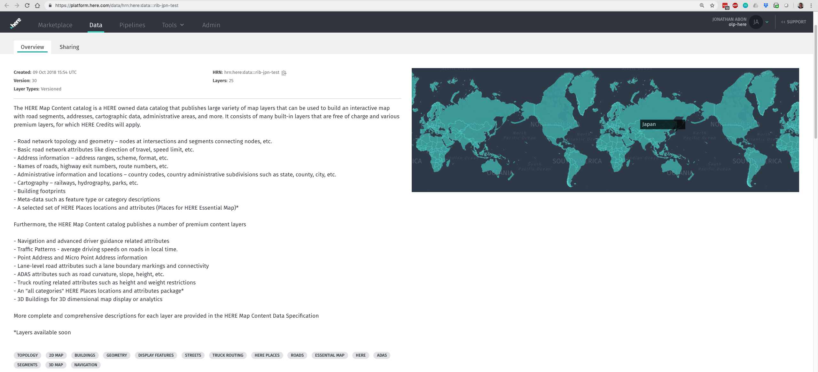
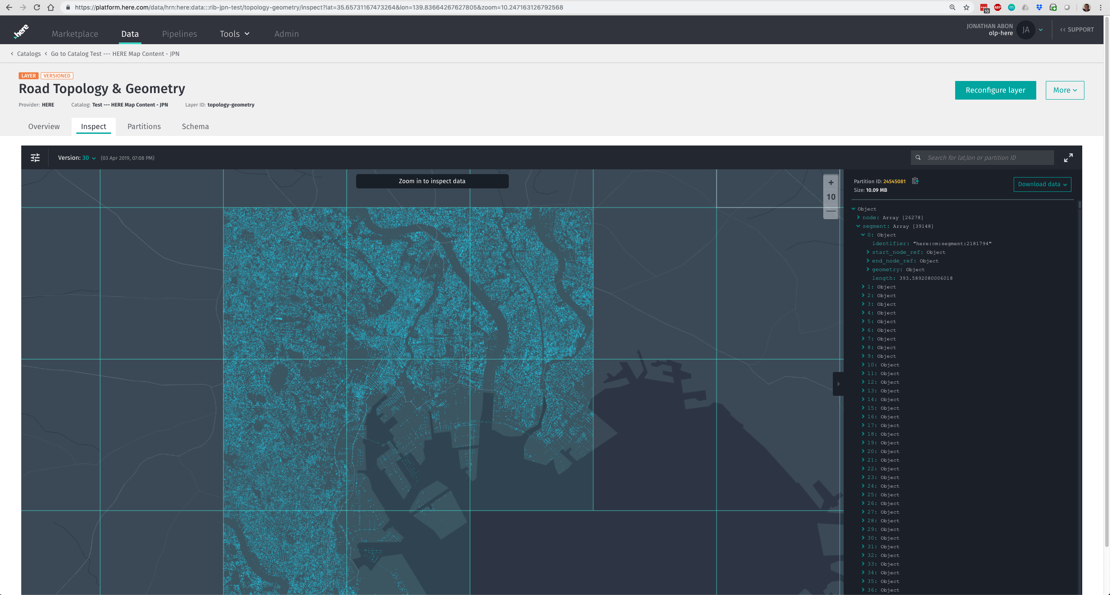
Japan map road topology and geometry layer visually explorable within OLP
Japan map content in an OLP catalog with multiple content layers

Slide 34
OLS portfolio consists of foundational Service Lines that provide developers access to ready-to-use capabilities AND customizable capabilities
Mobile SDK’s
REST API
REST API
REST API
REST API
REST API
REST API
REST API
Ready-to-use
“HLS Experience”
Javascript API’s
Open Search
Open Rendering
Open Routing
Open Transit
Open Positioning
Open Traffic
Open Venues
Provides current HLS interaction & business models
User Configurable Settings*
User Configurable Settings*
User Configurable Settings*
User Configurable Settings*
User Configurable Settings*
User Configurable Settings*
User Configurable Settings*
OLP Workspace and Marketplace
Customizable
“OLS Experience”
API
API
API
API
API
API
API
Provides OLP subscribers the capabilities to build their own services that leverage their own data using flexible configuration & customization options
* User configurable settings can be via OLP Portal and/or SDK
Notes:
Below are the existing HLS services which need to transform into OLS
Search (includes Search and Geocoder)
Places API
Geocoder API
Geocoder Autocomplete API
Batch Geocoder API
Rendering
Map Tiles API (bitmap tiles)
Map Image API
Vector Tiles API
Routing
Routing API
Public Transit
Transit API
Intermodal Routing API
Positioning
Positioning API
Traffic
Traffic API
Fleet Telematics
Fleet Telematics API
Fleet Telematics Custom Locations
Fleet Telematics Custom Routes
Fleet Telematics Advanced Data Sets
Fleet Telematics Route Matching
Fleet Telematics Toll Costs
Fleet Telematics Waypoint Sequence
Fleet Telematics Geofencing
Fleet Connectivity
Venue Maps
Venue Maps API

Slide 35
Open Search
Q3
The first of the Open Location Service (OLS)
Places (POI) geocoding
+
+
Custom HERE Map data sets
Bring Your Own Data (BYOD)
Geocoding
Search
NEW Capabilities
Bring Your Own Service (BYOS)
Faster data updates

Slide 36
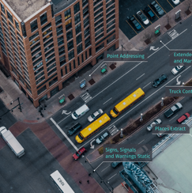
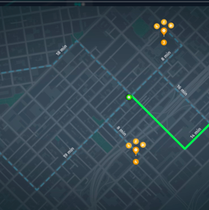
Open Search: More options for customization in the OLP Workspace
Customize HERE Map Content
Select only the data set you need from the HERE Map Content Catalog in OLP Workspace based on, e.g.:
Data type
Places category
Geography
Places quality level
Bring Your Own Data (BYOD)
I want to optimize audience targeting and deliver relevant ads to individuals inside a particular place
I want to reverse Places geocoding from coordinates to Place/Places Footprint. Is this person in a store, restaurant, public place; what is the place? what part of the place? BYOD: specific Places dataset; BYOS: adjust ranker or candidate generator
Bring Your Own Service (BYOS)
I modify default settings of API services to enable relevant and differentiating user experiences, e.g.:
Pipelines
Rankers
Personalization engines
Notes:
Search (aka Places API) – driving both Voice and Text applications from customers such as Amazon, BMW, Daimler, Honda and Hyundai.

Slide 37
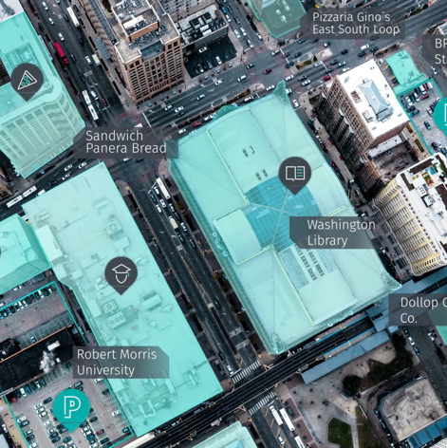
Example use cases for Open Search
Travel insurance call center
As a call center for an insurance company:
I need an app for the call center agents to search for legal firms located near my customers calling the contact hotline
I need to inform those customers about nearby lawyer offices with precise legal specialties, names, phone numbers and addresses
This data needs to be restricted and updated frequently
Audience targeting for advertising
Use your own proprietary and curated data sets and leverage quality of HERE Map Data and versatility of API Services within OLP Workspace, e.g.:
POIs
Mobile POIs
Private POI attributes
Road networks
Sensor data for e.g. real-time data
Emergency management
I want to respond precisely to a major disaster
I want the ability to track and manage a variety of moving assets and staff that are needed immediately
I want customizable search enabling BYOD and BYOS

Slide 38
Key benefits of Open Search
Increased accuracy
Places Geocoding improves geocoding accuracy
Freshest data
Tap into the largest global, highly accurate map data set (updated weekly and soon daily)
Unmatched flexibility
Select HERE Data, and bring your own data and services to meet specific needs (only through OLP)
Surpassing Google!
HERE now competitive Places offering + world-class geocoder and search services and uniquely offers customization via OLP workspace
Notes:
Features & Benefits
Feature / functionality: Combined Geocoder and Places Search functionality in one API with only one back-end Benefits:
easy to integrate
same search functionality as offered by other players in the market; on par now; one-stop shop
Combines best of both worlds - world class geocoder and access to one of the world’s largest Places databases

Slide 39
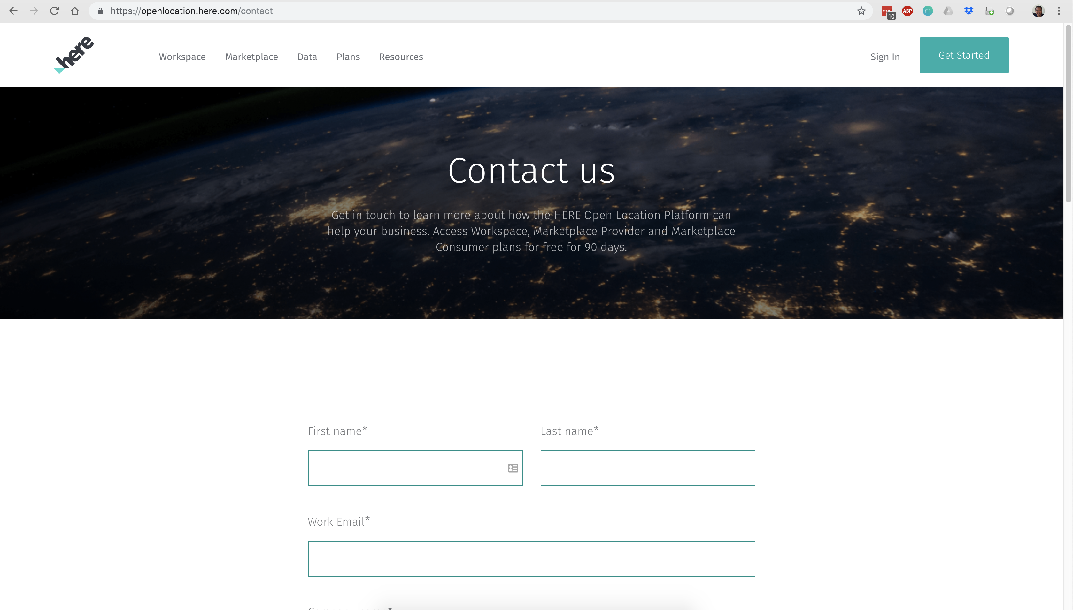
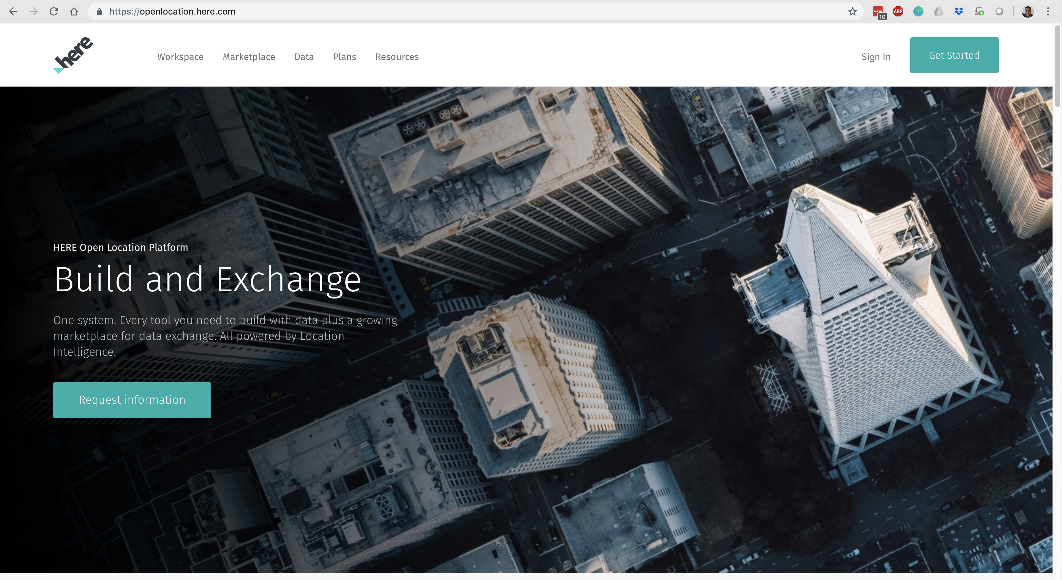
Call to action
Free trial
Let us help you understand and extract value from your data
Co-develop and innovate with you
More info at openlocation.here.com

Slide 41
Disclaimer

