Slide 1
Industry trends
Notes:
Introduction
Name – Function
Opening and welcoming guests back from lunch

Slide 2
Agenda
Overview | 3
Automotive | 12
Transport & Logistics | 43
Media & Advertising | 47
Public Sector and Infrastructure | 51

Slide 3
Global business trends
Protectionism and trade conflicts
Cyber threats
Key skills shortage
Sustainability
Large-scale migration
Notes:
These are exciting times with many trends impacting the business environment
Some trends are similar to last year, for example shortage of key skills and the threat of cyber attacks
Some trends have become more prominent, such as growing trade conflicts between leading countries

Slide 4
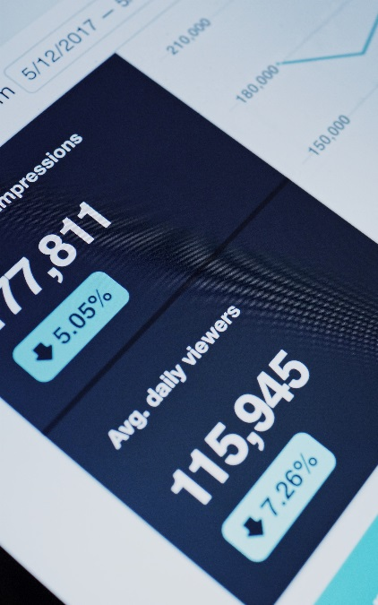
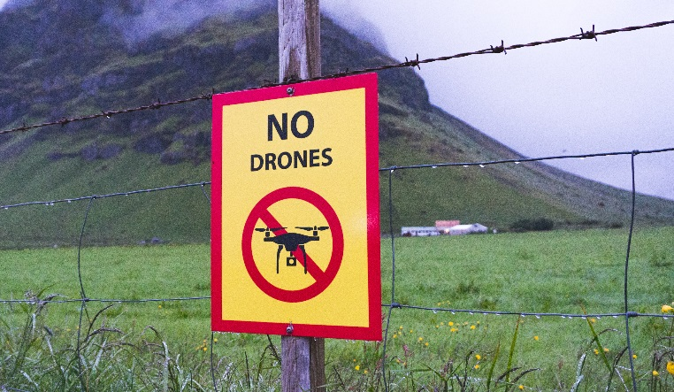
Global business trends
Economic outlook unclear
Data privacy and compliance
Geopolitical uncertainty
Over-regulation
Real vs. fake news
Notes:
The global economy is also less strong than last year, with growing uncertainty about the year ahead
Data privacy has become an important topic for many consumers
And we see many cases of over-regulation making life more difficult for companies

Slide 5
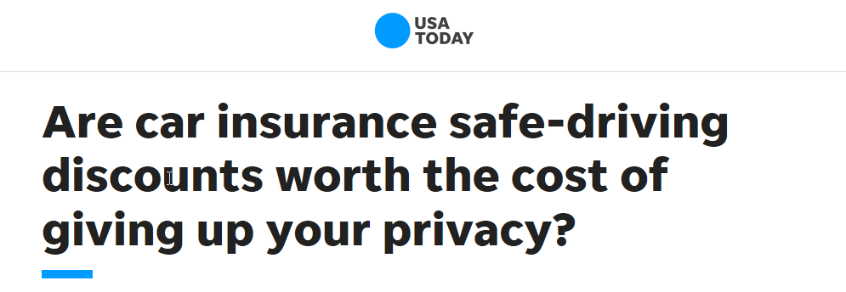
Automotive is not the only industry going through transformation...
Disruption is occurring in every industry
Transport & Logistics
Public Sector & Infrastructure
Media
Insurance
Notes:
And the automotive industry is not alone – every industry is seeing disruption and transformation
Many cities are banning older diesel cars and encouraging citizens to use public transportation
In transport & logistics, we see the entrance of new players and the emergence of end-to-end digital platforms
The media world – already disrupted – continues to see change like Apple getting into the content game with TV+
And finally, when it comes to insurance people are torn between attractive new pay-as-you-go models and the impact on their privacy

Slide 6
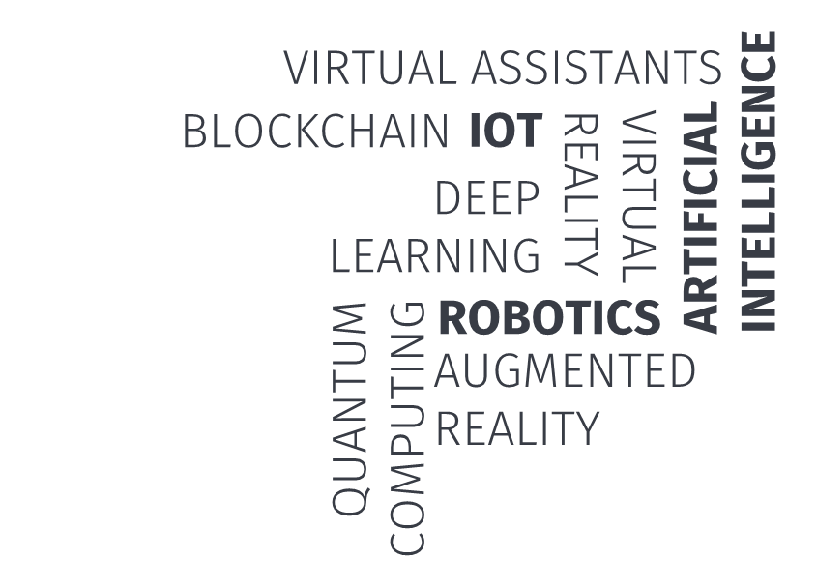
Industry dynamics are changing
Three key factors at play
2.
Rising customer expectations
3.
Industry lines blurring
1.
Impact of emerging technologies
Notes:
There are three key factors at play here
Firstly, emerging technologies like artificial intelligence and internet-of-things are starting to mature and have more and more impact
Secondly, consumers have higher expectations as they are conditioned by their experience in other industries
And finally, we see industry lines starting to blur. For example Apple introducing a credit card and Toyota and Softbank teaming up to form Monet, a mobility joint venture

Slide 7
Location intelligence is key to unlocking value in each industry
Notes:
In the midst of all these changes, we see location intelligence offering powerful new ways to create business value

Slide 8
Location intelligence is top of mind
Accelerate growth, streamline operations, manage risk
Location data is nearly ubiquitous at companies with over 500 people
"For which of the following does your organization use location data?"
Identify new customer markets
"Does your organization collect and/or store location data?"
41%
C-level
Yes
No
Improve marketing efforts
94%
37%
0%
20%
40%
60%
80%
100%
Improve customer service
36%
Businesses are planning to invest in location intelligence
Manage risks
"How likely are you to invest in location intelligence?"
34%
In the next 1 year
Optimize supply chain
78%
31%
In the next 3 years
Detect fraud
84%
26%
0%
20%
40%
60%
80%
100%
0%
10%
20%
30%
40%
50%
Notes:
Consider this recent survey held amongst business executives
94% of respondents indicate their company collects location data
And 84% say they are investing in location intelligence in the next 3 years
Why? Interestingly, there are many different reasons… I have listed a few on this slide
Location intelligence helps drive top-line growth, for example by helping to identify new markets or improving marketing effectiveness
But it also helps to streamline operations, like supply chain optimization
And location technology contributes to better risk management and fraud detection

Slide 9
Who can HERE help?
Automotive
Transport & Logistics
Electronics
Telecom & Utilities
Healthcare
HERE Open Location Platform
Retail
Insurance
Real Estate
Media
Public Sector & Infra- structure
Notes:
So location intelligence creates value across many industries and functional areas
With our leading map content, location services and open location platform, HERE is adding value to many industries today
Let me dive deeper into a few of these industries to make this specific for you

Slide 10
Automotive
Industry trends
Notes:
Automotive represents one of the key industries on the planet and for HERE the foundation for our business over the last 25years.
No doubt that Automotive goes through the biggest transformation or actually disruption ever.
Importance for us at HERE to analyse very closey what is happening and what implications and opportunities we can support for our customers.
At HERE we working with many different analysts and market research companies but of course we are also conduction our own research and various analysis. In this presentation we will be describing the transformation of the automotive industry from our perspective.

Slide 11
Drivers for disruption
Environmental concerns
Demographic change
Global macro- and socio-economic drivers
Health
Urbanization
Notes:
Multiple global and socio econmic drivers. I will focus on these 4:
An aging population
A greater focus on health, well being, sports, food
Urbanization pulls more and more poeple into mega cities in China and India but also all around the world
All this raises environmental concerns

Slide 12
Drivers for disruption
Behavioral Generation Y&Z view on automotive
Urban changes
City bans, multi-modal
Automotive industry constraints
Legislative Emission targets and penalties
Political Tariffs, Brexit
Notes:
The Automotive industry feals those gobal mega trends but is also impact by industry specific constraints:
Mega cities drive urban changes in order to provide mobility to their inhabitants. These include zones where cars are not allowed, owning and especially parking a car gets really costly.
Further behaviroral changes can be indentified, the younger generation of Y&Z are losing interst in cars, in urban areas less young people acutally get a drivers license. They focus on their digital life and the possibility „always on“ generats
Legisation is very active to adress the environmental concerns around CO2 and Nox by setting emission targets with associated penalties
And lastly there is a a lot of tension in the political enviroments in Europe with Brexit and globally about free trade and the possibility of increased tariffs on cars

Slide 13
Drivers for disruption
Connected
Automotive industry enablers
Massive development cost with sometimes uncertain or late ROI
Shared
Electrification
Autonomous
Notes:
These trends challenge the automotive industry and pushes massive development effort to react and enable future industry growth and sustainability.
CASE, ACES,… are the abbreviations summarizing four key enables. Connected Automated/autonomous, shared, electric
sometimes “normal” evolution [connected], sometimes mandatory to respond to industry constraints[electric])
Development of these technologies costs money and requires heavy cost saving programs at OEMs; ROI will happen far in the future

Slide 14
Example: Electric vehicles
Higher production cost likely impacting profit margin, additionally lower return on “mechanical hardware” over lifetime
EV production cost premium (2019): +$12.500
Service, maintenance & repair down: -42%
Assumes 50 kWh batter + powertrain
Base vehicle cost
Removal of ICE content
EV powertrain/ lower economies of scale cost
Total
Innovation requires considering new KPIs and additional business models
Source: UBS & McKinsey analysis 2019, *50 kWh battery + powertrain
Notes:
New Technologies don’t bring only a different sound they also bring new variables in the financial equation of the OEMs, as the relative high cost of technology development and production +12.5K€ is a premium EV more expansive to build than combustion engine . Complexity reduction (2000 moving parts in a combustion engine vs. 40 in ev) generate less lifecycle profits on the hardware alone for service, maintenance and repair.
So technology innovation cannot stop at the level of new technology but must look at new KPIs and additional business models too.

Slide 15
Redefining “Automotive”
$6.6 trillion
$3.5 trillion
Value pool of automotive industry today
Value pool of automotive industry in 2030
Source: McKinsey Report Dec 2017: Facing digital disruption in mobility as a traditional auto-player
Notes:
Despite this massive distriuption many industry consultants look at a massibly growing value pool of what Automotive was and how it will be redinfed over the next 10 years.
Redefinition of „Automotive“ due to a massively growing value pool enabled through Connectivity, Automation, Sharing, Electrifcation
„Specifically, OEMs and major suppliers will need to transform their products, as well as their capabilities and organizational structures, to survive and thrive. These changes present both great risk and great opportunity for the auto industry: while we expect the overall value pool to grow to $6.6 trillion in 2030 from $3.5 trillion today, traditional technologies and business models are expected to decline from 98 percent of the market today to 50 percent in 2030. Growth will be driven by disruptive technologies and business models in autonomy, connectivity, electrification, and vehicle sharing.“

Slide 16
Transformation of Automotive
Car
Connected smart car
Car as a Service
(CaaS)
Mobility as a Service
(MaaS)
Notes:
How does this transformation of Automotive actully happen. Holistic view
From the car over the connetect car to as a service models.
We will now dive deeper in each level and look at developments

Slide 17
Transformation of Automotive
Status quo
OEM traditional “car sales”
One car
One person
Notes:
Traditianal car ownership model. A person buys a car

Slide 18
Limits to organic growth
Traditional car sales expected to flatten out in the developed markets
Growth rate
2019-2022
+18%
ROW
Greater China
+12%
-4%
Japan/Korea
-4%
North America
+4%
Europe
Source: IHS April 2019
Notes:
Global car sales reaching ceiling, limiting organic growth potential
Generally: New car sales growth to large extent depending on economical factors (e.g. overall growing/shrinking economy, fuel price)
The worlds largest regions for new vehicle sales only with moderate growth outlook
SEA region currently an exception compared with global trends*, due to growing wealth and low delta (first owners)
Traditional Automotive industry is facing challenges to grow sales volumes indefinitely

Slide 19
Transformation of Automotive
Targeting 100% connected
Digital car and connected services
One connected car
One person
Notes:
The car is still bough by a person but becomes more and more connected, gets digital and opens for a new dimension of services

Slide 20
Connectivity providing growth opportunities
Connected cars penetration forecast constantly growing
ROW
Connected
Unconnected
30%
11%
APAC
Connected
Unconnected
45%
60%
North America
Connected
Unconnected
72%
80%
Europe
Connected
Unconnected
80%
85%
Source: IHS April 2019 & ABI research
Notes:
Connectivity growing. Mature markets more than ¾ today and more than 4/5 in 3 years but also APAC and ROW is adding connectivity to enable an additional digital life.

Slide 21
Connected cars can extract further value
OEMs are moving beyond hardware to software and services
Connected services (Data defined)
Traffic information
Safety services
Sensor data monetization
Entertainment
OTA updates/upgrades
Value-added services (Data enhanced offerings)
Fueling/Charging
Parking
Usage-based insurance
Connected maintenance
E-commerce delivery to trunk
Location-based advertising
ADAS and automated driving
Cruise control
Adaptive cruise control
Traffic jam assist
Highway pilot
Highly automated car
Notes:
Three categories
...
ADAS and the Automated driving area is kind of special in this as it is about taking over control of the driving it self.

Slide 22
ADAS – The road to automated driving
ADAS can increase consumer acceptance while technology matures
27%
9%
Would buy
Don’t know
Autonomous Vehicles interest in US
Technology maturity
Customer acceptance
ADAS
64%
L1
L4/5
Would not buy
Source: IPSOS/Reuters 2019 US Poll
Notes:
Regarding building customer trust we see two sides of the story
A recent US Poll from Reuters/IPSOS revealed quite some skepticism around Autonomous Vehicles around Americans. Which is expected as people need to build familiarity with assist systems before letting go of the control.
ADAS can help to drive customer acceptance for assistance systems and partial automation while technology is maturing from Level 2 to 3&4 and at some point to Level 5
ADAS can be the roald to automated driving

Slide 23
ADAS – The road to automated driving
Untapped potential in selling ADAS
80% of consumers interested in “driver assistance/safety systems” in their next car…
Most interesting ADAS features
…but only 52% of consumers actively informed by their dealer about ADAS functions.
Source: HERE Market Intelligence 2019 US Survey
Notes:
HERE did a study in North America to understand consumer interest in ADAS, which is overall high at 80% with a lot of focus around safety and comfort.
But even though 80% of consumers intersted in ADAS only 52% were actually informed by the car dealer about ADAS functions.

Slide 24
ADAS to full autonomy roll-out
More conservative forecast of higher level of autonomy
Global autonomous penetration of new passenger vehicle sales
April 2018 forecast
Source: IHS Data, HERE Extrapolation
Source: ABI Autonomous Driving forecast Dec. 2018
Notes:
.Initial forecasts of Automated driving revised recently with a more conservative approach (next slide). The industry is reacting the technology maturation and consumer acceptance. See comparison between April 2018 and December so only 8 months.

Slide 25
ADAS to full autonomy roll-out
More conservative forecast of higher level of autonomy
Global autonomous penetration of new passenger vehicle sales
December 2018 forecast
Source: ABI Autonomous Driving forecast Dec. 2018 + Industry Insights + Frost & Sullivan
Notes:
The analyst forecasts are also consistent with what we are seeing in the industry:
Between 2019 and 2021 9 OEMs to introduce L2 driving capability. By 2023 15 OEMs expected to have this in their production vehicles
The first 3 OEMs expected to come with L3 capability around 2021 and by 2025 15 OEMs to have L3 capability.
First OEMs to bring L4 capability after 2025

Slide 26
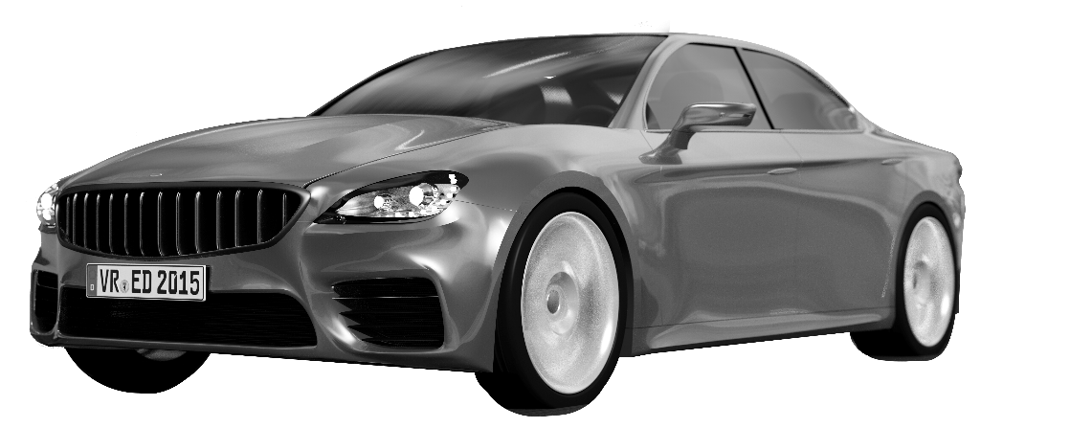
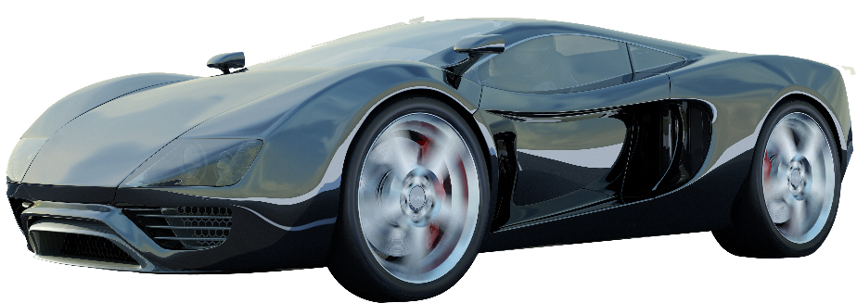
Tremendous investment into higher automation
Difficult mid-term outlook on ROI for privately owned autonomous
Human
Machine
Self-driven
private vehicle
Autonomous
private vehicle
Notes:
But back to our overall all the automated private car will not be possible without embedded high speed and high reliable connectity.
High invest into automation and also high cost for consumer to buy/own Autonomous car. Expecting limited ROI mid term. Requires considering new business models and redefiniton of tradital Automotive

Slide 27
Transformation of Automotive
“XaaS” or the shift to flexible consumption models
Car as a Service
Mobility as a Service
Pool of connected cars
Many people
Connected multi-modality
Everybody
Notes:
We are witnessing fundamental shifts that are creating both tremendous opportunities and threats:
From “selling a vehicle“ to one individual to “enabling use of multiple connected modes of transportation and logistics to everyone“
Becoming a beneficior of change requires large upfront invest.
Dynamics are speeding up with growing customer adoption. Even faster with young, tech savvy demographics.

Slide 28
Connected multi-modality accelerates growth…
New mobility models opens additional dimensions for the industry
Car as a Service
Mobility as a Service
Car rental
Car sharing
Ride sharing
Ride hailing
Notes:
Car as a service
Where the mean of transportation is provided
To
Mobitliy as a service
Where the ride it self is the product
Both dimensions are not new think of car rental or taxis. But with connectivity, smartphones and cloud platforms new dimensions of services can be offered.

Slide 29
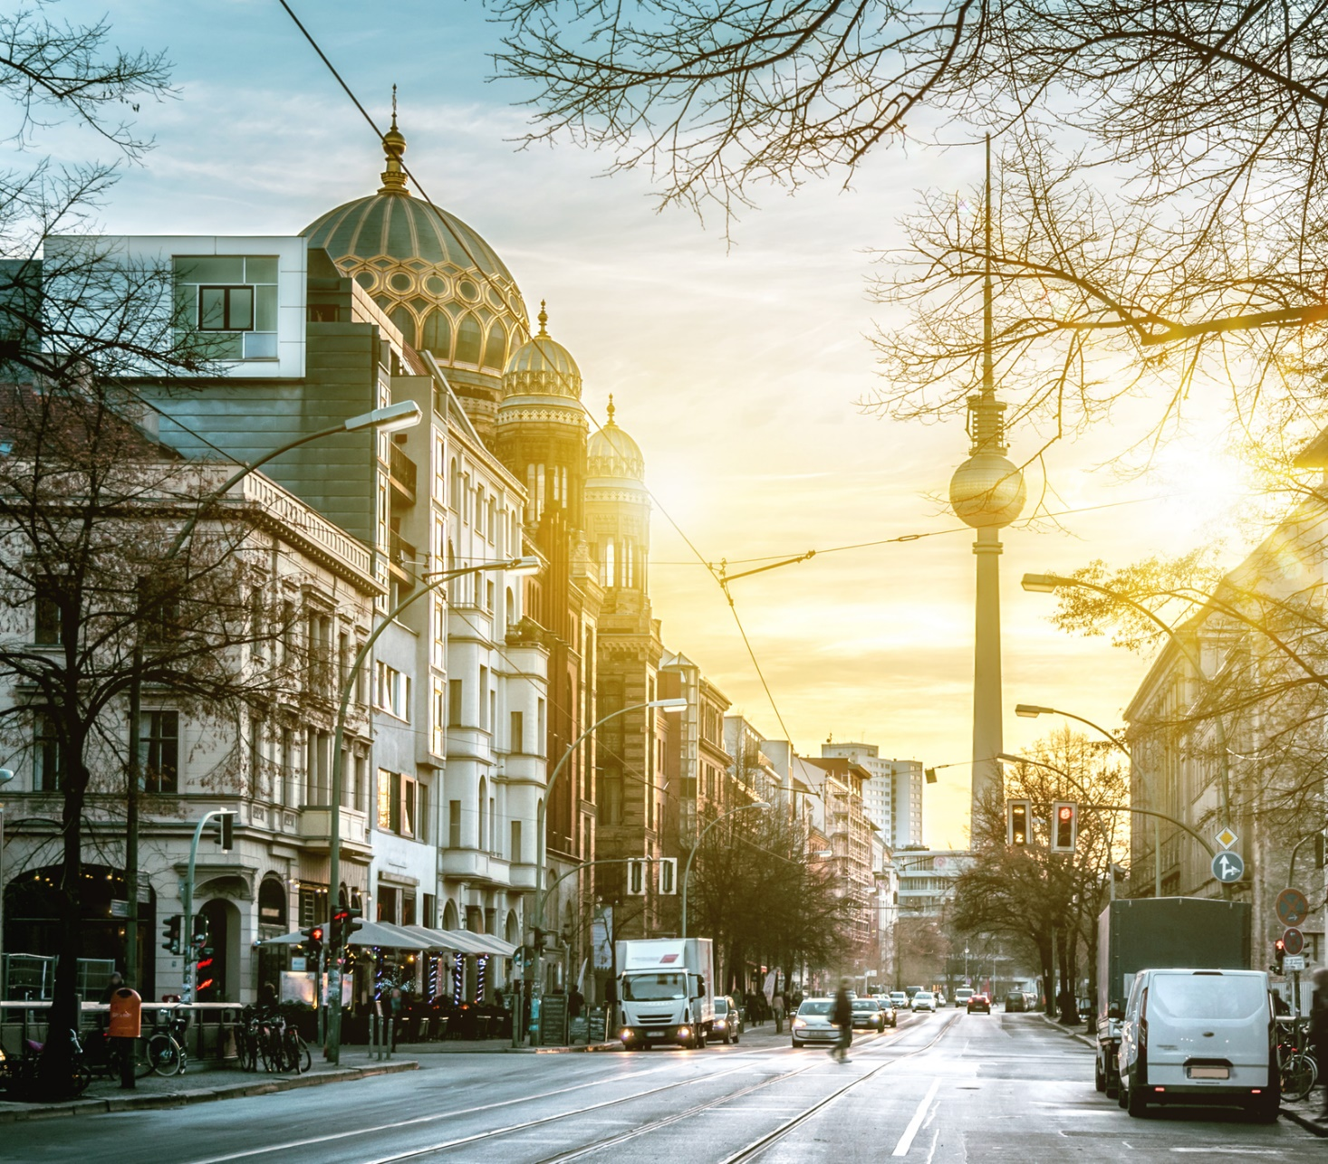
…but there is no “one-size-fits-all” mobility model
Market segmentation at city level adds complexity
Car as a Service
Mobility as a Service
Notes:
Berlin, for example, runs on convenient car sharing, with multiple players and limited e-hailing opportunities because of taxi-related regulation.
Beijing, a mid-income, densely populated city, has a shared-mobility market of more than $700 million. Focused mainly on a strong e-hailing platform, Beijing is a winner-takes-most market where one company controls nearly the entire market. |McK: https://www.mckinsey.com/industries/automotive-and-assembly/our-insights/how-shared-mobility-will-change-the-automotive-industry]
car sharing is rarely economically viable in cities with fewer than half a million inhabitants.
As shared mobility continues to gain momentum, automakers and their suppliers need to understand what’s driving its popularity, which will vary from country to country and city to city. While shared mobility will probably inhibit new vehicle sales to an extent, automotive players can nonetheless position themselves to benefit from its ultimate success.

Slide 30
XaaS requires a deep and solid stack
Complexity requires substantial investment and invites new entrants
On-demand
mobility
Frontend & UX
Payments & CRM
Demand match & operations platform
- B2C -
Automotive
services
Vehicle supply & operations
Aftersales, maintenance
Financial services
- B2B/B2C -
Vehicle
Connected car services
Automation stack
Vehicle
- B2B -
Notes:
Not every OEM can master the entire stack which in abstracted form consists of three layers. The car – autmotive related services – and the b2c front end with the on demand mobility platform
Requires a more open, collaborative stance
Characteristics of platform biz in mobility:
data-driven, user-centric
relies on a strong platform
Enables at least planning, booking, payment
Asset light (e.g. Uber) vs. Asset heavy (e.g. ShareNow)
Private vs. Public (e.g. city mass transit)
Subscription or pay-as-you-go = Platform charges fee X
Efficiency optimization with analytics for matching demand & supply

Slide 31
Jockeying for position
Fierce battle for market share
Traditional OEM & T1
Traditional auto-related service providers
New entrants
Notes:
New mobility is a less than a decade old but already creates billion dollar valuations and investments long before profits are expected.
OEMs are investing in and developing Mobility services to not get left behind Uber, Lyft, Grab, Didi and others
However: Tech Players invest significantly more into related startups than automotive players.
Total investments of $111 billion from 2010 – 2017
Of which $31 billion was invested in 2016 alone.
And of this $31 billion, automotive players invested less than $2 billion (about 6%). However, the R&D budgets of auto players in 2016 were $77 billion—more than twice as high as the total investments identified, and nearly 40 times higher than investments by auto OEMs. These players need to take action if they want to stay in the race for technology.
Why: Airline example
Consumer loyalty shifts from the HW manufacture to the mobility brand
e.g. As consumer I don‘t care if I‘m flying Boeing or Airbus but I‘m loyal to „my“ perferred Airline (Lufthansa, Thai, etc.) because of their brand promise (safety, luxury, good service, cheap prices,....

Slide 32
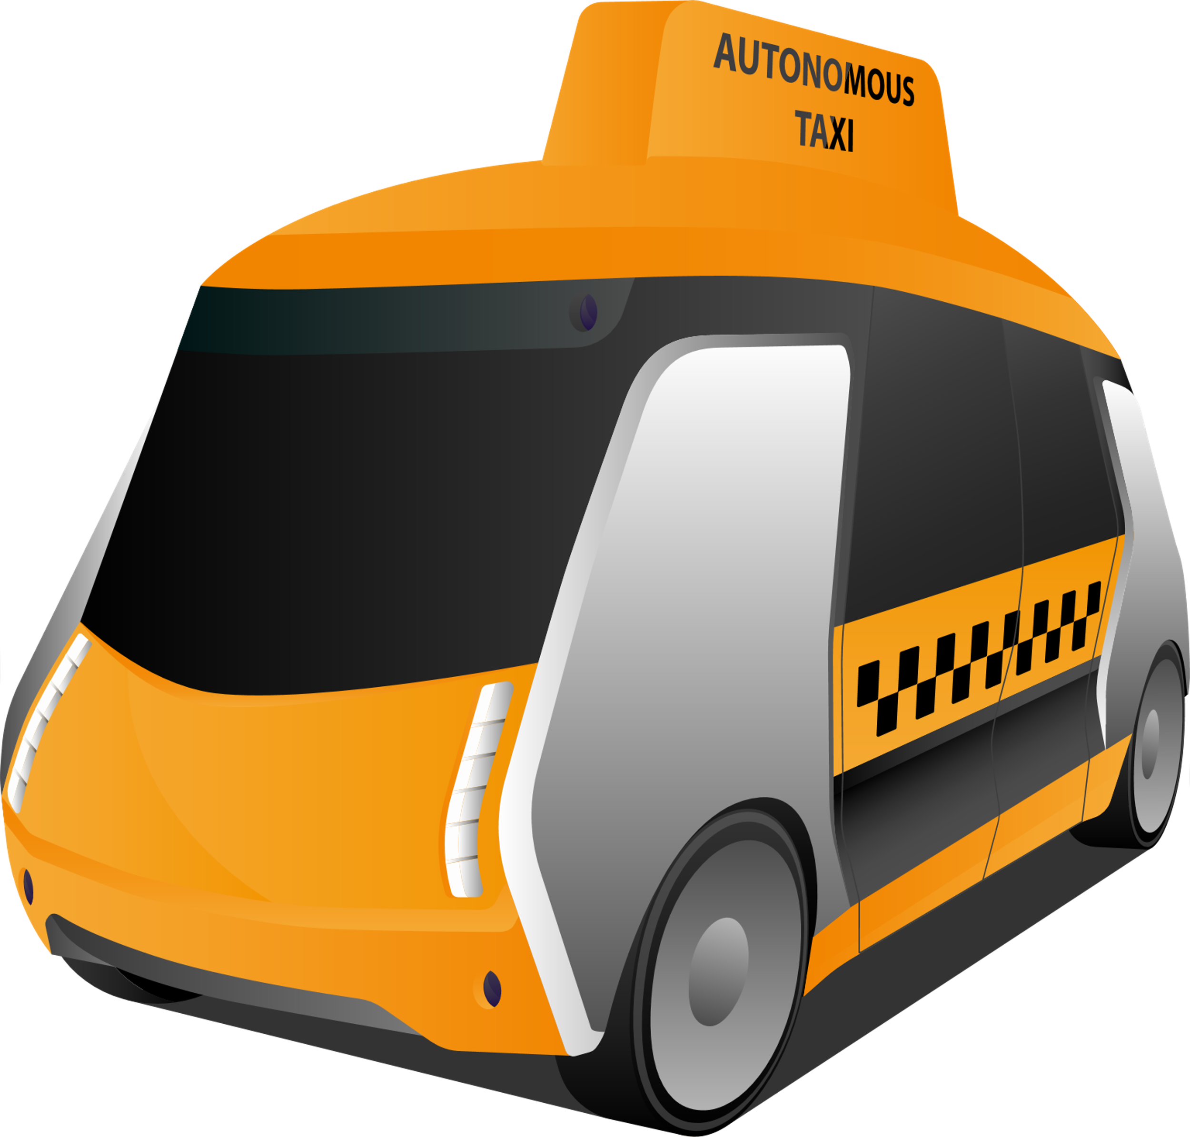
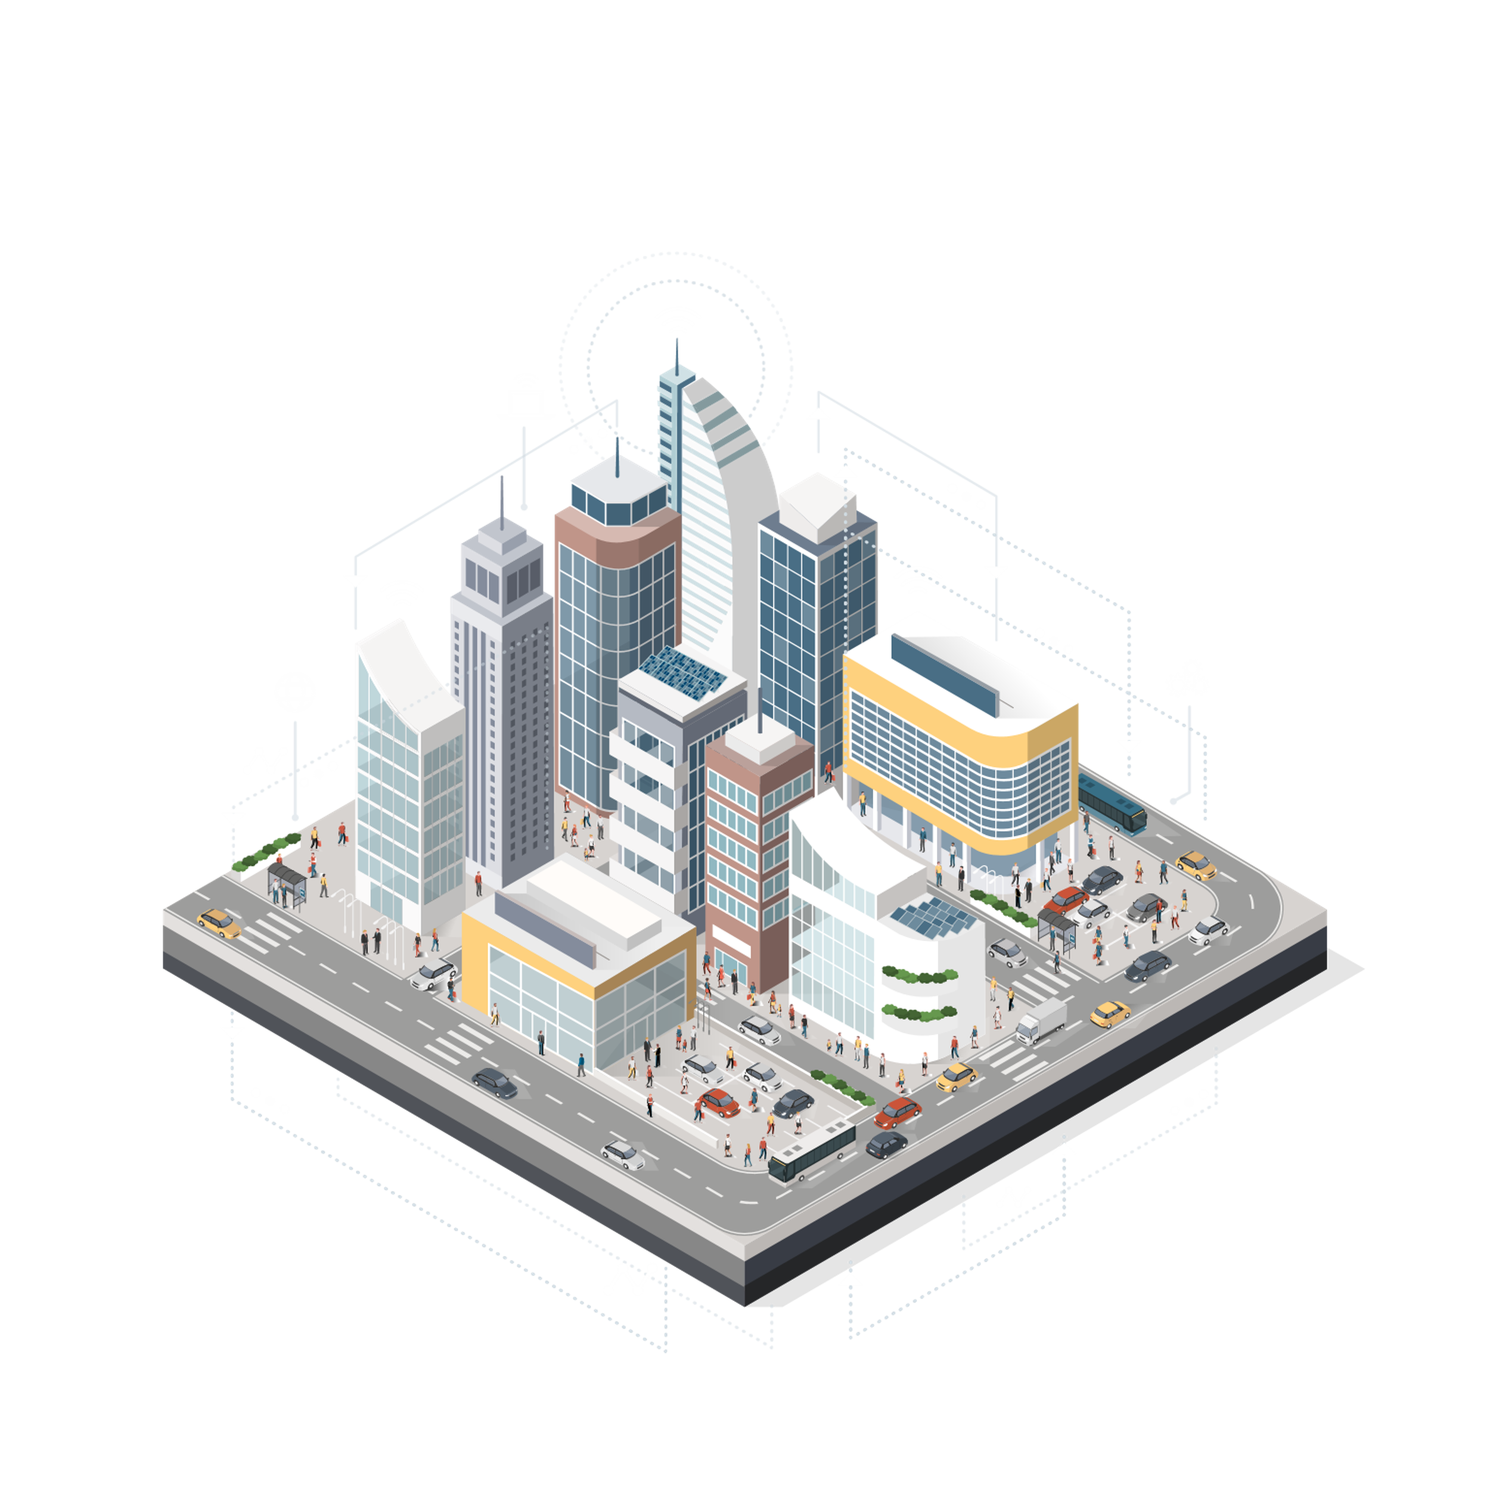
Manifestations of the mobility of the future
OEMs and new entrants are occupying different domains…
Autonomous
private vehicle
Autonomous
shared vehicle
Technological excellence
Self-driven
private vehicle
Self-driven
shared vehicle
Platform excellence
Notes:
From
Self driven, private:
Largest market share in transportation, expected to decrease significantly by 2030
Self driven, shared:
Ride-hailing with strong growth
Controlled by few platform companies
Autonomous, prviate:
Low to moderate growth between til 2030.
Premium/luxury good
Autonomous, shared:
Fast growth between 2025 – 2030.
Highly competitive market. Unclear who will come out ahead (OEM’s, ride-hailing platforms, autonomous technology providers)
Asian markets expected to have some of the fastest growth

Slide 33
Transformation of automotive and its value chain
High stakes
$
Battleground
t
Notes:
The green shade area stands for the new defintion of autmotive and its new value. It attracts new players.
and thus battle ground for future automotive business growth.
Established Automtive OEM and Suppliers vs. Start-ups and Big Tech who are also trying to enter the car...

Slide 34
Trojans knocking at the gate…
To integrate the car in their connected living ecosystem
Notes:
This redefined Automotive industry which is suddenly an open system and not exclusivly controlled by car OEMs anymore is also attracting Big Tech who are now looking to secure controll points in the car.
(before CASE nobody had access to the driver while he was using the car >>> closed Ecosystem controlled by the OEM. Only the mobile phone....)
The redefined Automotive is becoming attractive for Big Tech and they want to integrate “automotive” in their connecting life ecosystem. Not too long ago the car was shielded from the connected life of a consumer

Slide 35
Initially with brought-in-solutions (BIS)
All major brands have launched Android Auto and/or Apple CarPlay
Apple CarPlay
Android Auto
Display Audio
Notes:
Brought in solutions are now at all major brands and as a result the OEM brand becomes secondary on the screen
Fragmented and two-layered user experience: consumers increasingly incapable of differentiating between OEM IVI and BIS
Car Play / Android Auto apps can substitute OEM proprietary services (e. g. parking, speed signs) and thereby stand in the way of monetization
Users don’t perceive the OEM brand as a digital service provider

Slide 36
Potential penetration impact of brought-in over embedded navigation
Risk of significant shifts to take place
Europe
North America
Without AA/CP
With AA/CP
Without AA/CP
With AA/CP
Source: HERE Analysis 2018
Notes:
HERE analyisis Navigation penetration rates closely and we build our own models and how this could look like for the future
Looking at previous years growth rates we saw Europe growing from 60% to 65% where North America only from 40% to 45%.
Strange that EU is so much higher than NA.
now with AA/CP we believe that industry penetraion rates could drop and take them down to below 60% or below 40%.
We also did a consumer study....

Slide 37
Consumer interest in ENS higher than car dealers assume
Customer interest by age group and dealer influence – US study
Customer interest in embedded navigation
by age
Dealer influence
by age
Source: HERE Embedded Navigation Study - January 2019
Notes:
Some people in the industry might question: what are consumers actuall thinking?
We wanted to get to the bottom of things with one of our latest studies in the US, the market that sees strongest impact currently.
So we asked for consumer interest in embedded navation which is super high in all age groups but intrestingly the dealer tried to influcene the the consumer especially in the younger cluster against navigation and suggested AA/CP as better alternative....
Sounds a bit like a self fulfilling provecy: because some might think consumer don‘t want embeeded nav no embedded nav is offered which then provides sales data underlining that consumer want less embeeded navigation-

Slide 38
Big Tech entering the car with full stack
Notes:
But Big tech is not only entering the car through the phone but also by providing a complete stack. It makes the car a part of the conncted living ecosystem of these big tech players.
Why?
A car owner spends 50 minutes per day in the car – monetizing this time represents a significant revenue potential
For every minute of time in the car, monetized global digital media revenues of EUR 5 billion p.a. could be generated. This excludes any hardware revenues
If only 5 minutes of the average time spent in a car are monetized, a global EUR 25 billion revenue pool with high profitability emerges

Slide 39
Open outcome
Possible scenarios for automotive OEMs
High
OEM as hardware
platform provider
OEM as data, services and mobility champion
$$$
Technological innovation
Fallen OEM
Stagnant OEM
Low
High
+ Big Tech Big Auto + Balance of power
Low
Notes:
Big Tech ambitions in Automotive
Quo vadis for traditional OEMs:
Fallen giant (consolidation, exit)?
Stagnation (no added growth)?
Hardware platform provider (“metal bender“)?
Data and mobility manager (direct consumer reach)?
Source: Deloitte, Automotive Value Chain Model

Slide 40
Conclusion
Automotive industry is under a massive redefinition process and needs new business models for growth
New competitive battleground is not around hardware but about services, data, mobility and an ecosystem play
1
2
OEMs and Tier1 are looking for their place in the value chain and need to invest heavily in new technologies
HERE brings solutions that support key industry needs around the connected, shared, electric and automated vehicle
3
4

Slide 41
Transport & Logistics
Industry trends

Slide 42
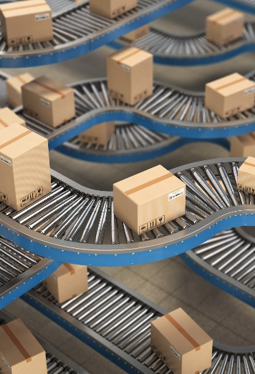
Transport & Logistics
Companies face numerous challenges
Notes:
Let’s start with the transportation industry, which faces a number of real challenges
ETA, or estimated time of arrival, is often difficult to calculate or inaccurate
There are many manual transactions in the long value chain
Visibility of shipments is not always clear
Handover from one mode of transport to another is inefficient

Slide 43
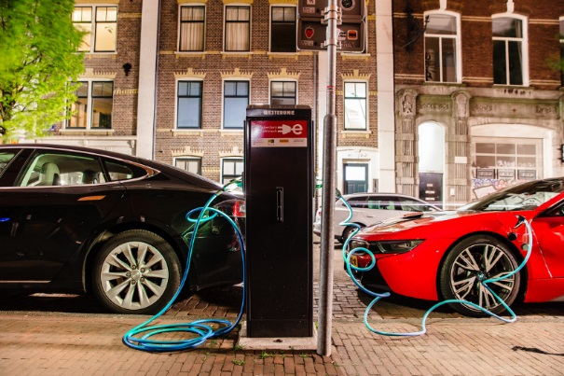
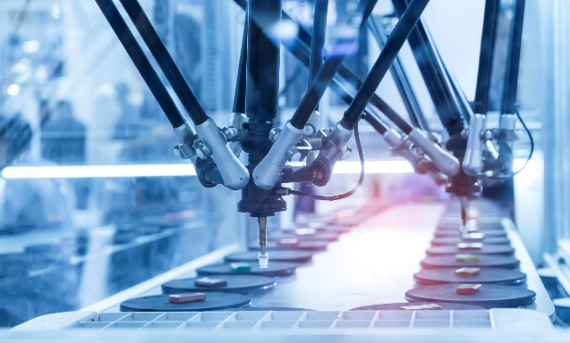
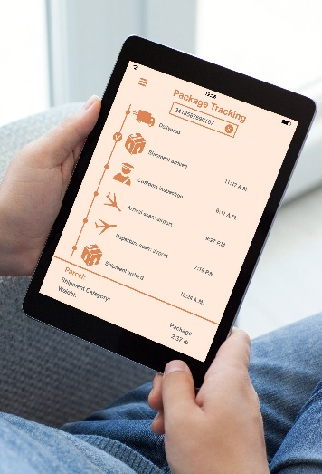
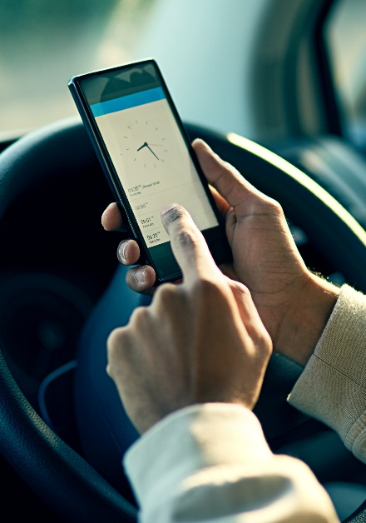
Transport & Logistics
Goal: Efficient end-to-end supply chain processes
Notes:
By using real-time location intelligence, planning can be improved and ETAs become much more accurate
We are able to track good wherever they are, even indoor, with amazing precision
We can enable better handover from one mode of transport to another by increasing visibility of vehicles and shipments
And we can increase driver utilization by bundling shipments and reducing the number of empty trucks on the road

Slide 44
Transport & Logistics
Use case: Enabling end-to-end tracking of assets – anytime, anywhere
HERE in Action
HERE has collaborated with Sodales Solutions, a software company whose products allow businesses to track customer and business interactions.
Fleet management solutions can be achieved by bringing together data from the driver, customer, enterprise and other outside forces. This means that trucks, products and resources can all be tracked in real time.
Reference customers:
Notes:
We work with many of the world’s leading transport & logistics companies like Fedex, UPS and DSV
We have developed high-quality tracking technology to enable real-time visibility
And we have formed a number of partnerships like SAP but also smaller companies like Sodales whose software helps to create complete solutions for the transportation industry

Slide 45
Media & Advertising
Industry trends

Slide 46
Media
Companies face numerous challenges
Notes:
Now let’s turn to media & advertising, which is also relevant for industries like retail, real estate and internet
Again, there are many pain points today
People are not watching main stream TV like they used to; media consumption is highly fragmented
Consumers are spending more time on their smart phone than ever before
As a result, targeting the right audiences is not easy
A large part of the advertising budget is wasted, and return on investment is difficult to measure

Slide 47
Media
Goal: More precise targeting
Notes:
Using HERE technology, we are able to more precisely target consumers based on their location
We can enable more relevant, location-aware messaging using multiple channels like mobile and digital out-of-home
We can also link advertising to an actual purchase in a physical store
As a result, both effectiveness of spend goes up and return on investment is easier to establish

Slide 48
Media
Use case: Providing reliable data and insights to an accelerating industry
HERE in Action
HERE supplies location data to businesses that provide marketing intelligence.
Location-targeted mobile ads
US marketers are poised to double their spend between 2017 and 2021 to $32 billion, according to research firm BIA/Kelsey.
Notes:
We have an exciting partnership with Adsquare to add location intelligence to marketing execution
Location-based mobile ads is a market that is growing fast – estimated to double between 2017 and 2021 to $32 billion

Slide 49
Public Sector and Infrastructure
Industry trends

Slide 50
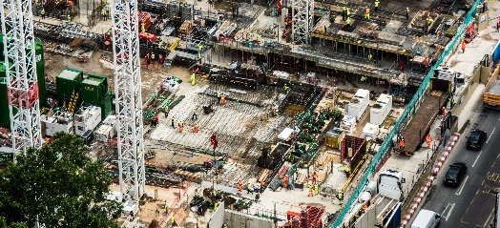
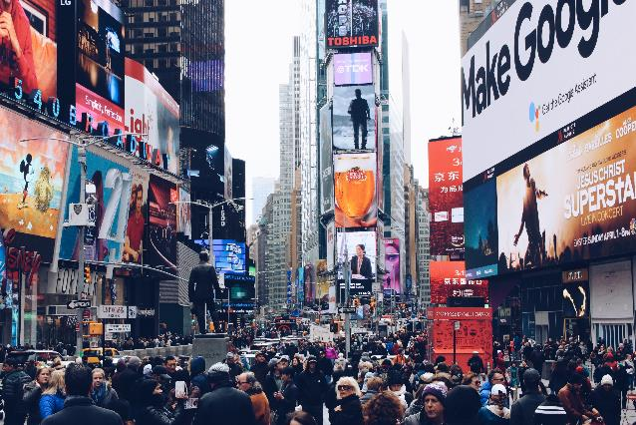
Public Sector & Infrastructure
Governments face numerous challenges
Notes:
Finally, the public sector
As cities grow exponentially, they all face similar challenges: pollution, congestion, safety and the need to efficiently deliver government services

Slide 51
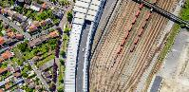
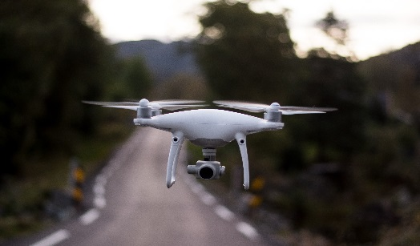
Public Sector & Infrastructure
Goal: Ensure a better quality of life for citizens
Notes:
Location intelligence is core to creating a modern, safe, livable city
Let me share a few real examples of how we are supporting some leading cities around the world to illustrate

Slide 52
Public Sector & Infrastructure
Use cases
Chicago
Hamburg
Dubai
Solve congestion and pollution caused by increase in consumer e-commerce activity
Share data for curbing pollution and enhancing road safety by improving traffic flow
Jointly work together on executing the Self-Driving Transport (“SDT”) roadmap
Notes:
Although every city shares a number of common challenges, they also each have their own unique issues to deal with
Therefore, we like to engage with different cities around the world to learn

Slide 53
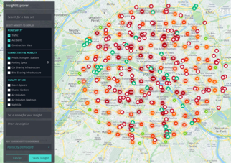
Public Sector & Infrastructure
Chicago
Hamburg
Dubai
Use cases
Chicago
Solve congestion and pollution caused by increase in consumer e-commerce activity
Hamburg
Share data for curbing pollution and enhancing road safety by improving traffic flow
Weekday truck speed in Chicago
Chicago streets avg. weekday truck congestion @ 5 pm
Hamburg industry ecosystem & marketplace
20th percentile
50th percentile
80th percentile
Free flow
Light
Moderate
Heavy
Very heavy
Notes:
Chicago struggles with heavy congestion due to e-commerce delivery vehicles
We are working with the city and private delivery companies to manage the traffic in specific areas, using our map content, routing service and real-time traffic
This allows the people of Chicago to get to work when they need to

Slide 54
Public Sector & Infrastructure
Chicago
Hamburg
Dubai
Use cases
Chicago
Solve congestion and pollution caused by increase in consumer e-commerce activity
Hamburg
Share data for curbing pollution and enhancing road safety by improving traffic flow
Dubai
Jointly work together on executing the Self-Driving Transport (“SDT”) roadmap
HD Map view show-casing different tile approach and high-lighting standard map view vs. HD Map view
Weekday truck speed in Chicago
Chicago streets avg. weekday truck congestion @ 5 pm
Hamburg industry ecosystem & marketplace
20th percentile
50th percentile
80th percentile
Free flow
Light
Moderate
Heavy
Very heavy
Notes:
Hamburg has a major port in the heart of the city
We are working with the city to make sure road traffic is alerted when bridges open for ships, so that trucks get re-routed and do not sit idle
This reduces congestion and pollution, while enabling further growth of the port

Slide 55
Public Sector & Infrastructure
Chicago
Hamburg
Dubai
Use cases
Hamburg
Share data for curbing pollution and enhancing road safety by improving traffic flow
Dubai
Jointly work together on executing the Self-Driving Transport (“SDT”) roadmap
HD Map view show-casing different tile approach and high-lighting standard map view vs. HD Map view
Hamburg industry ecosystem & marketplace
Notes:
Dubai has the ambition to lead in the area of self-driving transportation (buses, trains, cars)
HD Live Map is key to making this a reality

Slide 56
Enabling use cases end-to-end with multiple HERE products and services
Emergency services
Notes:
Let me close off by sharing a very practical example of how our location intelligence powers a use case in the public sector
Let’s look at emergency services

Slide 57
Notes:
First we use positioning technology to pinpoint exactly where the incident is… in this case a fire
Then we leverage vehicle sensor data to determine the location of ambulances in the area; in this situation there are 4 available
If we then deploy our routing algorithms we see that traffic is limiting the ability of 2 ambulances to get to the site quickly, leaving 2
But because we also have access to the latest weather information, we can see that 1 of those 2 ambulances will face slippery roads due to ice
That’s leaves 1 vehicle which is best suited to respond
When arriving at the scene of the fire, indoor maps can assist the emergency response team by guiding them to the right location inside the building

Slide 58
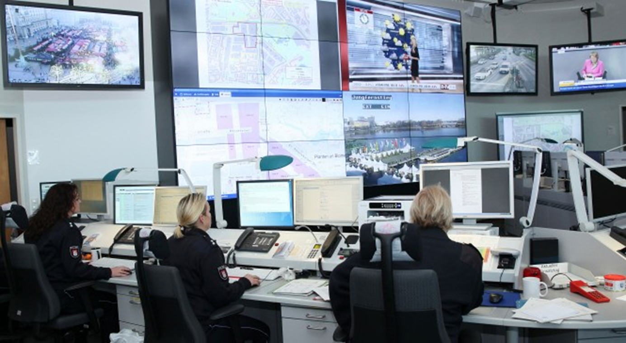
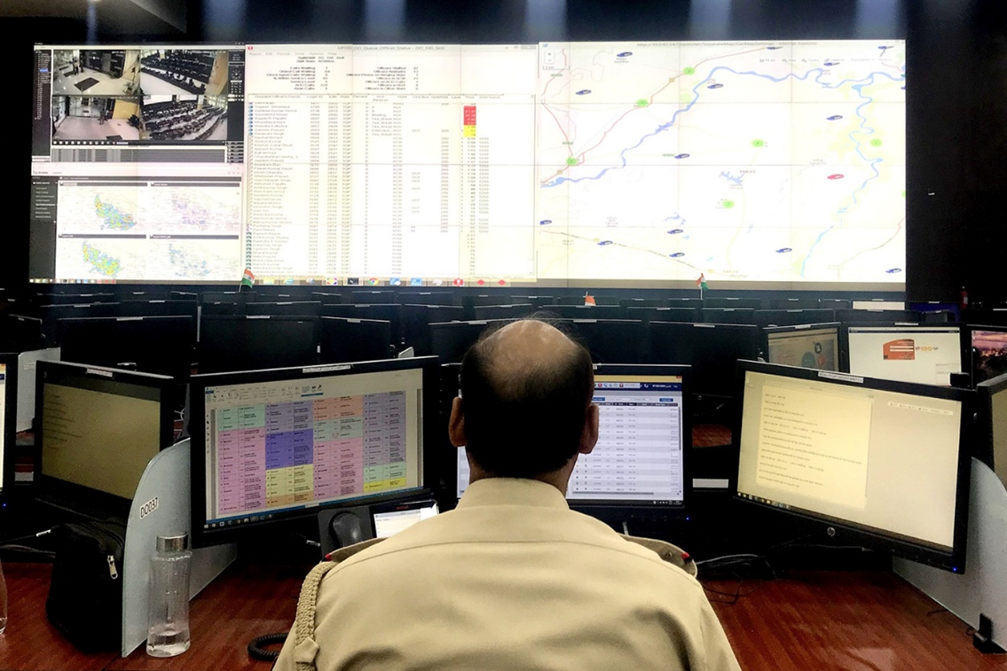
Emergency Services
Use cases
Notes:
We have two great references for this emergency services use case
One is in Hamburg, which hosted the G20 summit in July 2017. HERE Technologies, Esri and other partners built a platform which integrated many data sources into a single, map-based interface that could be accessed through a web-based portal. This gave officers access to information in the command center and in the field
In India, HERE and HEXAGON launched a high-tech police response system in the state of Uttar Pradesh (population 200 million; 232,000 police officers and constables). By positioning police vehicles and officers strategically based on distance, route and area coverage, the response time was dramatically lowered for both urban and rural areas.

Slide 59
We’re HERE to partner with you
We are making sense of the world through the lens of location, and using location intelligence to positively change lives with data-driven location solutions
Notes:
I hope this gives you a sense of how location intelligence creates business value in different industries, and can lead to positive change in society
It would be our honor to work with you to see how HERE can support your business objectives

